Slide 1
Self-supervised Learning and Contrastive Learning
Ying Shen
Sse, tongji university
Sep. 2023

Slide 2
Today...
How do learn rich and useful features from raw unlabeled data that can be useful for several downstream tasks?
What are the various pretext (proxy) tasks that can be used to learn representations from unlabeled data?
How can we improve data-efficiency and performance of downstream tasks with a good pre-trained network?
Notes:
⾃监督学习算法分为两种： 生成式自监督学习与对比式自监督学习
生成式：训练编码器将输入x编码成显式向量z，解码器从z重建x，最小化重建误差；
对比式：编码器将输入x编码成显式向量z以度量相似性（例如互信息最大化）。（对⽐学习要做的就是学习⼀个编码器f，这个编码器f能够拉近x与其正样本间的距离，推远x与其负样本之间的距离
Proxy tasks（辅助任务/代理任务）：其中辅助任务的指的是为达到特定训练任务⽽设计的间接任务，pretext任务的好处是为了简化原任务的求解，在深度学习中就是避免人工标记样本，实现⽆监督的语义提取。Pretext任务可以进⼀步理解为：对⽬标任务有帮助的辅助任务。主要pretext task包括：图像旋转、图像着⾊、图像修复，即类似于数据增强的操作。
根据认为设计的不同的pretext方法，自监督可以分为：
基于上下文context：预训练LM、蒸馏、数据增强、伪标签、self-training等
基于时序
基于对比：contrastive learning通过对比学习来完成自监督学习
https://blog.csdn.net/weixin_43135178/article/details/126354825
https://blog.csdn.net/weixin_43135178/article/details/126349526
https://zhuanlan.zhihu.com/p/470914640
https://zhuanlan.zhihu.com/p/474847821

Slide 3
Representation Learning

Slide 4
Depth refines representations

Slide 5
Deep learning is one way to learn features

Slide 6
Deep learning is one way to learn features
Deep Unsupervised Learning:
Learn representations without labels
Subset of Deep Learning, which is a subset of Representation Learning, which is a subset of Machine Learning

Slide 7
Deep learning is one way to learn features
Deep Unsupervised Learning:
Learn representations without labels
Subset of Deep Learning, which is a subset of Representation Learning, which is a subset of Machine Learning
Self-Supervised Learning
Often used interchangeably with unsupervised learning
Self-Supervised: Create your own supervision through pretext tasks

Slide 8
Why Self-Supervised Learning?
Expense of producing a new dataset for each task
Prepare labeling manuals, categories, hiring humans, creating GUIs, storage pipelines, etc.
Good supervision may not be cheap (ex: medicine, legal)
Take advantage of vast amount of unlabeled data on the internet (images, videos, language).
Cognitive motivation: How animals / babies learn

Slide 9
Why Self-Supervised Learning?
Give a robot a label and you feed it for a second, teach a robot to label and you feed it for a lifetime
- Pierre Sermanet

Slide 10
What is Self-Supervised Learning?
A version of unsupervised learning where data provides the supervision.
In general, withhold some part of the data and the task a neural network to predict it from the remaining parts.
Details decide what proxy loss or pretext task the network tries to solve, and depending on the quality of the task, good semantic features can be obtained without actual labels
Notes:
什么是自监督学习？自监督学习主要是利用辅助任务（pretext）从大规模的无监督数据中挖掘自身的监督信息，通过这种构造的监督信息对网络进行训练，从而可以学习到对下游任务有价值的表征。所以对于自监督学习来说，存在三个挑战：
对于大量的无标签数据，如何进行表征学习？
从数据的本身出发，如何设计有效的辅助任务 pretext？
对于自监督学习到的表征，如何来评测它的有效性（如何评测自监督学习的能力）？【自监督学习的能力主要由下游任务的性能来体现】

Slide 11
Motivation
Supervised learning success story is heavily because of the utility of pre-trained classifier features for commercially useful downstream tasks like segmentation, detection, etc.
Recipe is clear: Collect a large labeled dataset, train a model, deploy. Good data and sufficient data are what you need.
Goal of self-supervised learning:
Learn equally good (if not better) features without supervision
Be able to deploy similar quality systems without relying on too many labels for the downstream tasks
Generalize better potentially because you learn more about the world

Slide 12
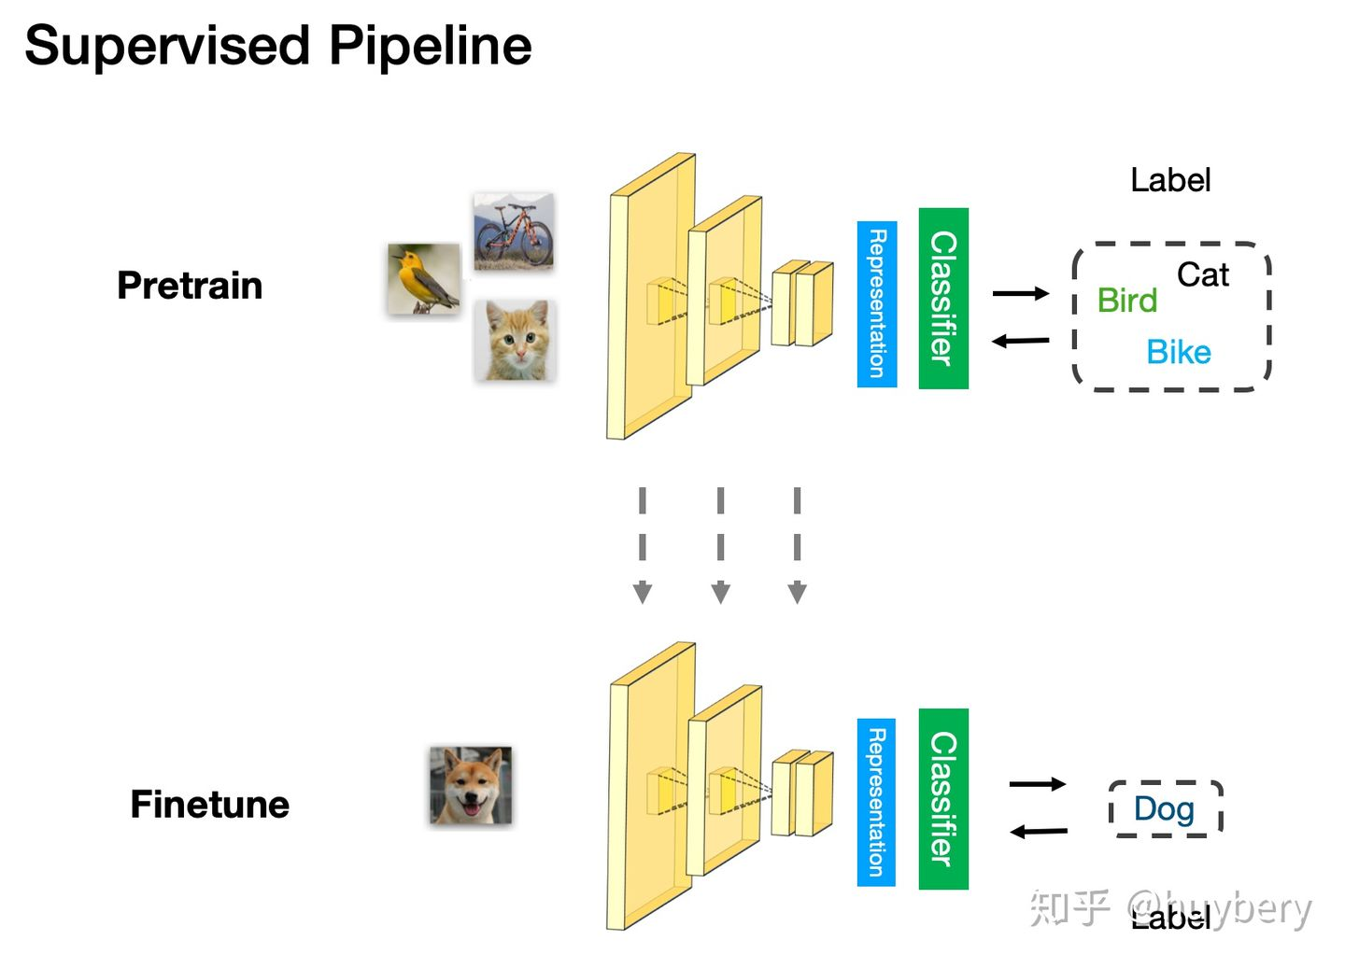
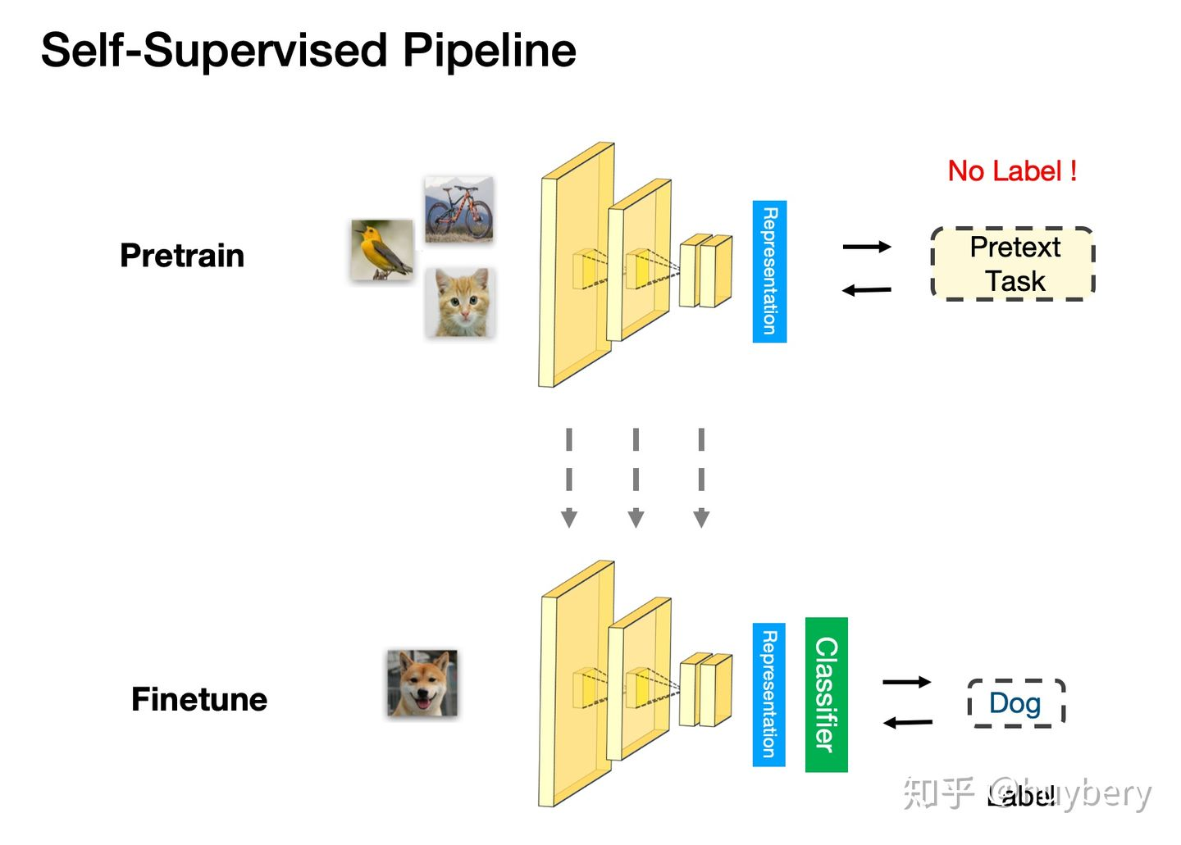
Motivation

Slide 13
Motivation

Slide 14
Cognitive Principles
Context based
Denoising Autoencoder
Relative patch prediction
Jigsaw puzzles
Predict one view from another
Task related self-supervised learning
Temporal based
Contrastive Learning
DIM
Contrastive Predictive Coding (CPC)
Memory Bank
SimCLR
Recent State-of-the-art progress

Slide 15
Denoising Autoencoder

Slide 16
Denoising Autoencoder

Slide 17
Denoising Autoencoder

Slide 18
Denoising Autoencoder

Slide 19
Emphasizing corrupted dimensions

Slide 20
Denoising Autoencoder

Slide 21
Predict missing pieces

Slide 22
Context encoders

Slide 23
Context encoders

Slide 24
Context encoders

Slide 25
Context encoders

Slide 26
Context encoders

Slide 27
Context encoders

Slide 28
Relative Position of Image Patches
Task: Predict the relative position of the second patch with respect to the first

Slide 29
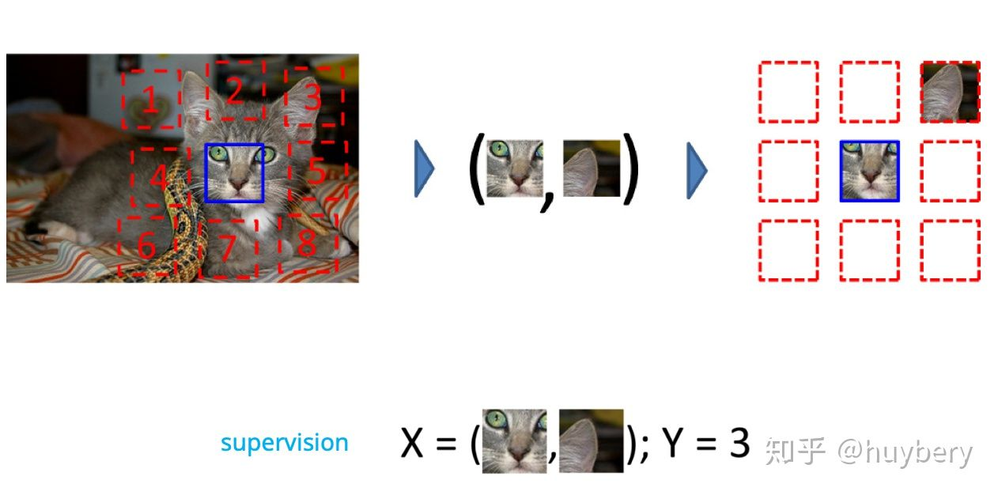
Relative Position of Image Patches

Slide 30
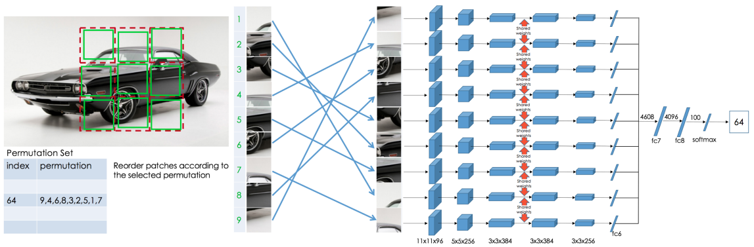
Relative Position of Image Patches
Mehdi Noroozi and Paolo Favaro, ECCV 2016

Slide 31
Predicting one view from another

Slide 32
Predicting one view from another
Notes:
将灰度图上色是一个难题，因为灰度图损失了原图三分之二的色彩信息. 因此论文对灰度的处理是一种“看似合理”的上色，根据场景的语义和物体表面的纹理，比如（从纹理识别出来的）草显然是绿色的，天空是蓝色的，瓢虫大部分是红色为底色；但语义优先（默认某种物体属于某种颜色，比如草是绿色）并不符合所有的对象，比如草地上的一些彩球，渲染后不同的彩球颜色实际上是人为设定的，并不一定反映出真正的彩球颜色. 因此这篇论文并不是为了恢复灰度图原本的色彩，而是对灰度图渲染出合理和谐的颜色.
考虑搭配亮度通道L，该系统预测图像在CIE实验色（CIE Lab）中的相应的a和b通道的值. 论文采用了大规模的训练数据. 训练数据充足（任何彩图均可），将图片的亮度通道L作为输入，输出ab通道的值作为监控信号. 而在前人的工作中，由于训练数据容易获取，前人使用CNNs训练对图片颜色进行预测，然而结果饱和度太低，并不理想. 究其原因，这些模型使用的损失函数是从标准回归问题中继承，模型为了最小化output和label之间的欧氏距离而使得输出图片远远偏离真实图片.
相反，针对着色问题，论文定制了损失函数。考虑到颜色预测本质是一个多模态问题——许多物体可采取多种合理的颜色上色. 比如苹果可以是红的、绿的、黄的，但不可能是蓝的或者橘的. 为了合理地对问题的多模态性质建模，作者对每个像素预测一个可能颜色的分布. 此外，论文通过重新衡量训练时的权重来强调一些稀有颜色. 这就使得模型能够利用大量训练数据中的颜色多样性. 最后，通过分布的退火平均值（the annealed-mean of th distribution），形成最后的上色模型. 最终上色结果更鲜活，在感知方面也比前人成果更加真实.
评估合成图像是众所周知的难，因为论文的终极目标是使得着色图能够使人信服，所以论文引进了“着色图灵测试”，直接让人类参与者对着色图片进行真假判断. 论文展示了一些逼真的着色图，说明甚至有些图片真实到能直接作为后续工作流中的数据，尤其是在另一篇论文中的对象分类工作中.
论文额外探索了图片着色作为自我监督表现学习的形式，在自我监督表现学习中，生数据被作为自身监督的来源.（这段内容还讲了一些摘要提到的、和托词任务相关的内容，由于和我感兴趣的部分没太多关联，大致看了一下，就不做笔记了）
最后提到了在这篇论文的贡献主要在两方面. 第一，推动了自动图片上色，通过a)设计了一个适当的目标函数来处理着色问题的多模态不确定性，并捕获广泛的颜色多样性 b)引进了一个测试着色算法的新颖框架，潜在地可应用到其他图片合成任务中 c)通过训练百万以上的彩图，设定了这项任务一个新的高度；第二，论文将着色任务作为一个具有竞争力和直接的方法引进到自我监督表示学习中，在几个基准上达到了先进的水准.

Slide 33
Predicting one view from another

Slide 34
Predicting one view from another

Slide 35
Predicting one view from another

Slide 36
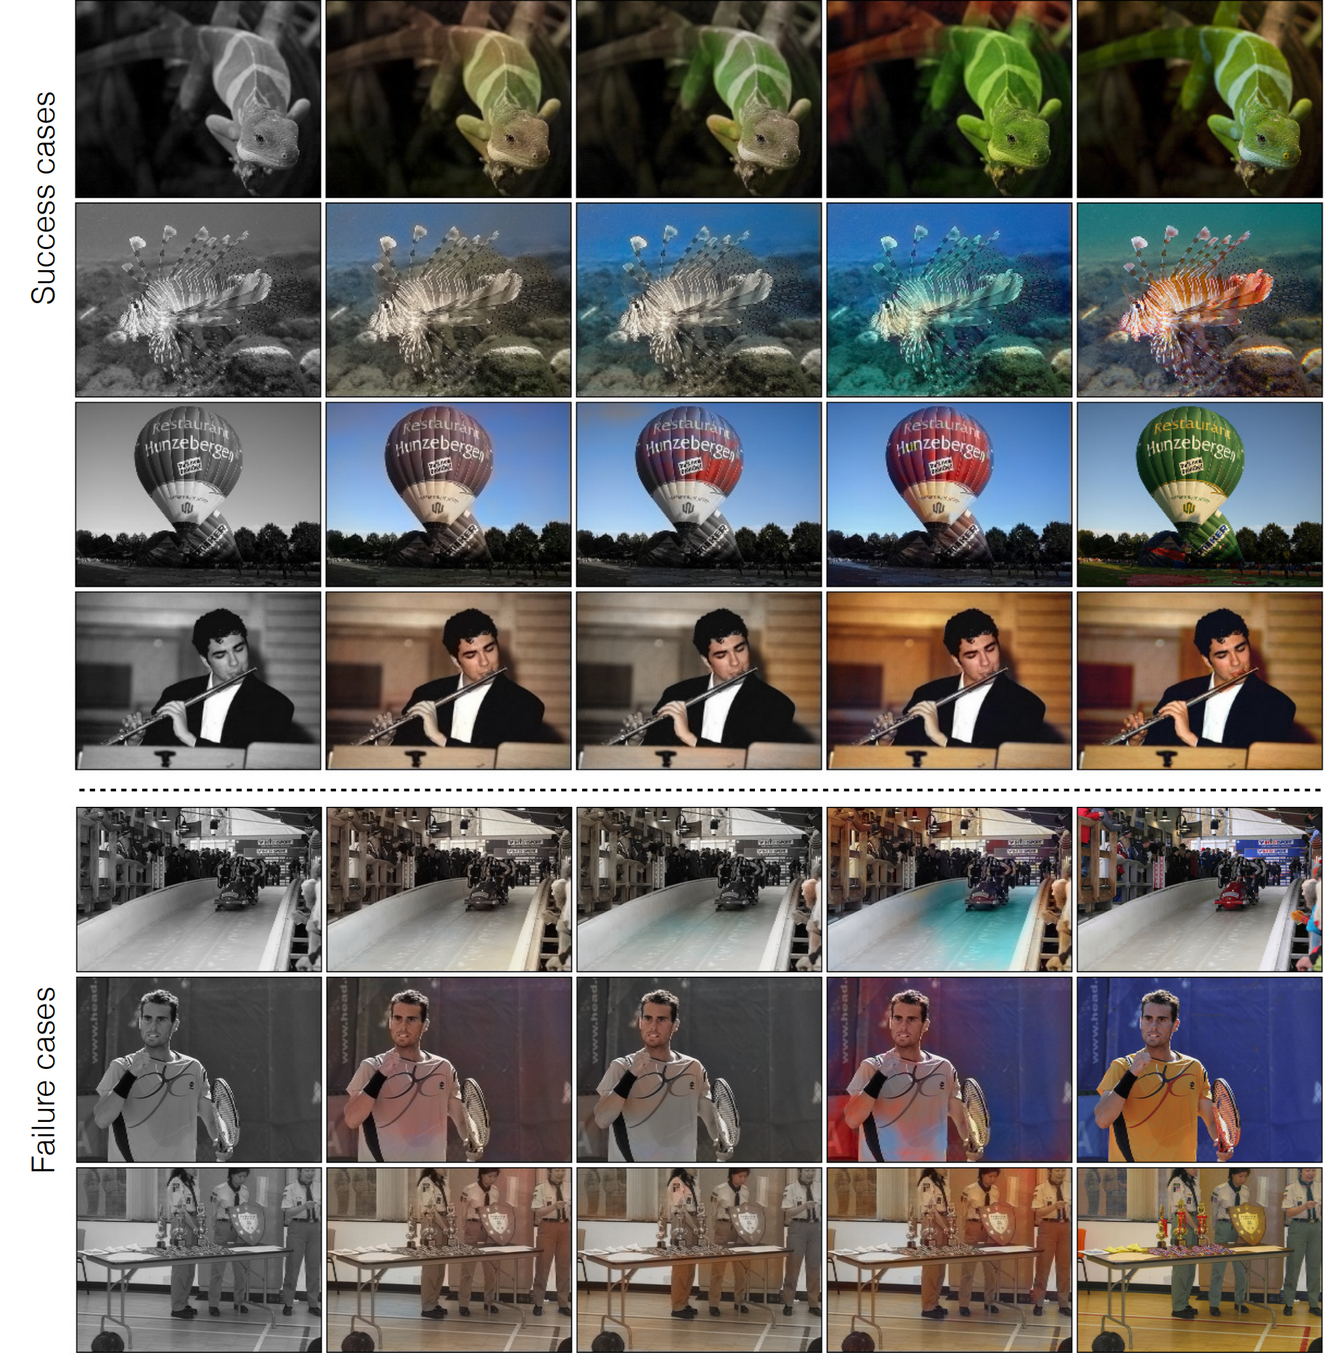
Predicting one view from another

Slide 37
Predicting one view from another

Slide 38
Predicting one view from another

Slide 39
Predicting one view from another

Slide 40
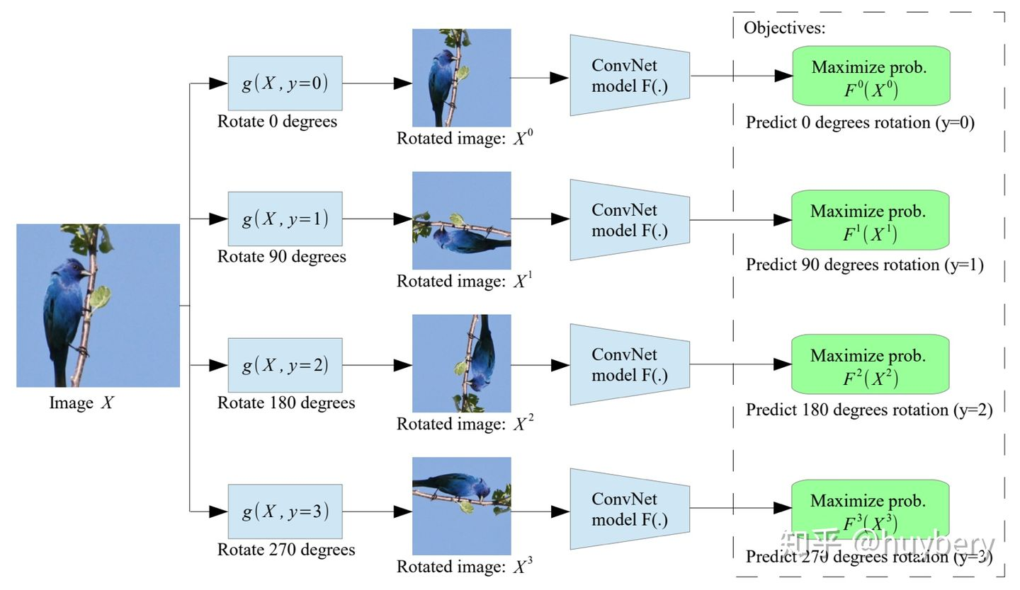
Task related self-supervised learning
Notes:
Gidaris, Spyros et al. “Unsupervised Representation Learning by Predicting lmage Rotations." In ICLR 2018
作者提出了利用训练卷积网络识别对于输入图片的旋转角度来进行提取图像特征，即作为一个辅助任务(pretext)。简单的说，作者利用卷积网络构建了一个模型，该模型可以用来对输入图像的旋转角度进行分类，旋转角度分为0°90°180°270°输入进一张经过随机旋转90“整数倍的图片，输出结果为预测出图片旋转角度即对于4个角度的概率值，概率值最高的即为图片的旋转角网当得到训练好的辅助任务模型后，作者通过实验比较利用辅助任务的前飞层单独拿出来作为上游任务，权重固定保持不变《即进行济结)，下游任务根据具体任务进行搭建网络结构，然后利用监督学习来训练下游任务的模型。
作者为啥设计这样的辅助任务呢? 作者在论文中解释道:我们认为，为了让 ConvNet 模型能够识别应用于图像的旋转变换，它需要了解图像中描绘的对象的概念(参见图 1)，例如它们在图像中的位置、它们的位置类型和他们的姿势。

Slide 41
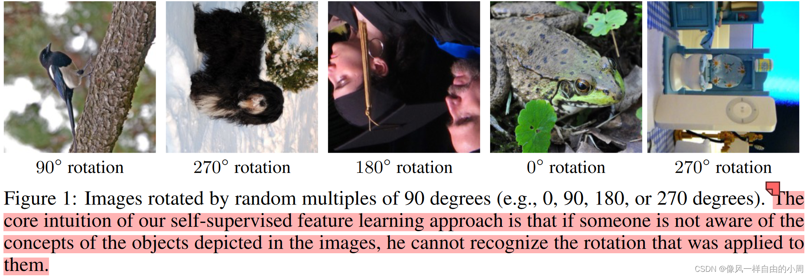
Task related self-supervised learning

Slide 42
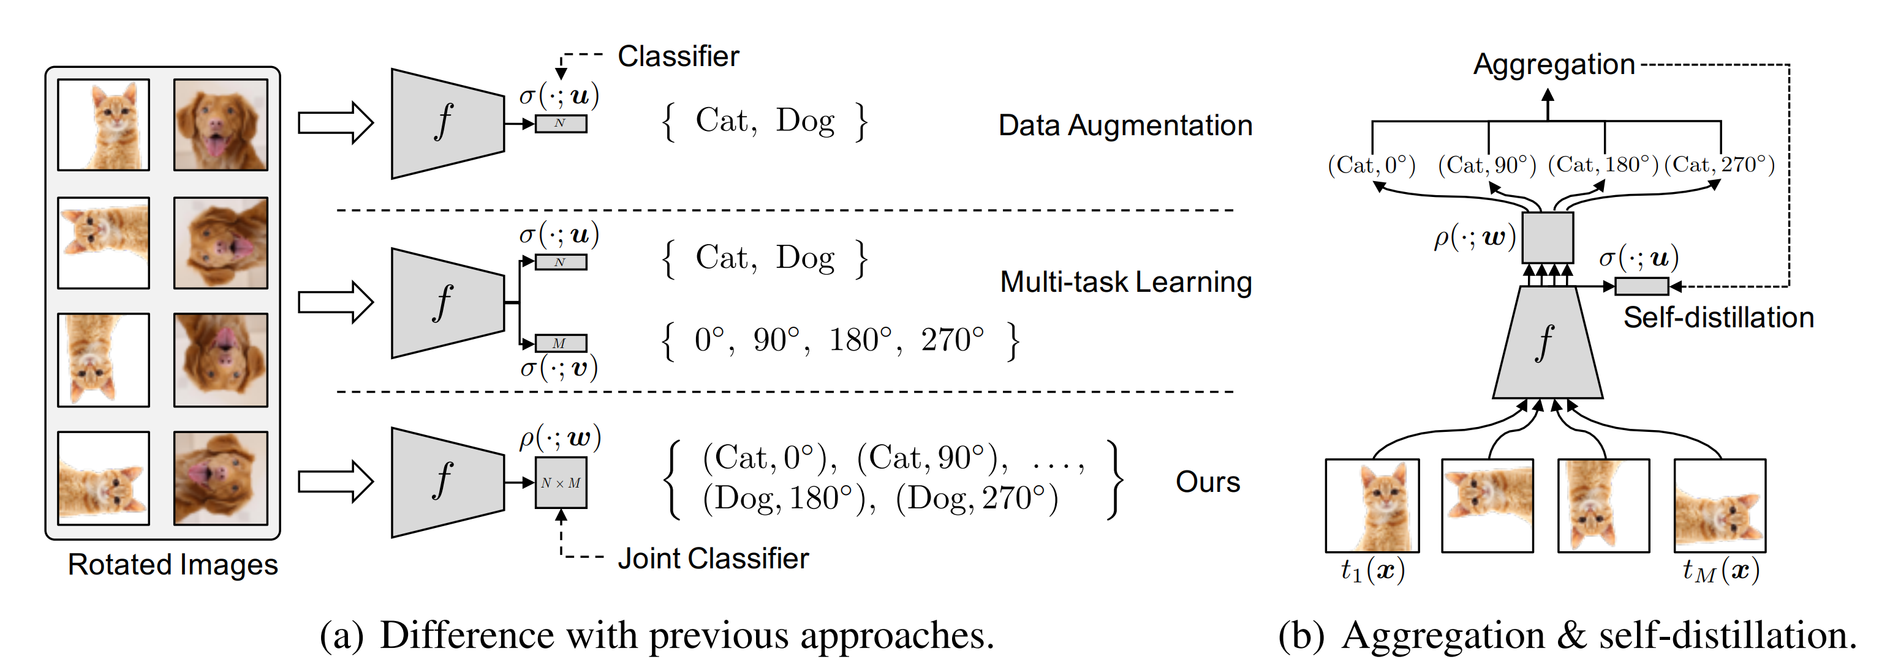
Task related self-supervised learning
Notes:
Lee, Hankook et al [14]探索了在多任务学习中增加自监督学习的可能，他们将普通的分类任务中嵌入了旋转预测任务。
Lee. Hankook et al."Rethinking Data Auamentation: Self-Supervision and Self-Distilation." ArXiv abs/1910.05872 (2019):

Slide 43
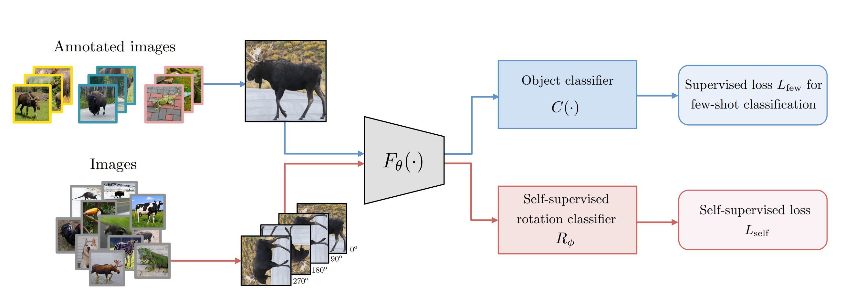
Task related self-supervised learning
Notes:
除了简单的多任务学习，也可以设计联合学习策略，直接预测两种监督信息。同样的想法也被用到了小样本学习[15]中，一个分支进行传统的小样本分类，另一个分支来进行自监督旋转预测，虽然这篇文章的想法和设计不是很亮眼，但提升还是比较明显的。
Gidaris, Spyros et al. “Boosting Few-Shot Visual Learning with Self-Supervision." ICCV 2019

Slide 44
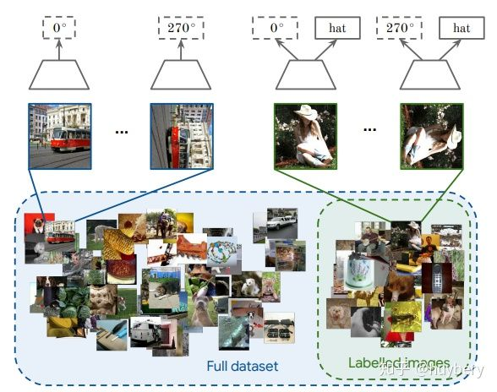
Task related self-supervised learning
Notes:
而自监督和半监督学习(16]也可以进行结合，对于无标记的数据进行自监督学习(旋转预测)，和对于有标记数据，在进行自监督学习的同时利用联合训练的想法进行有监督学习。通过对 imagenet 的半监督划分，利用 10% 或者 1% 的数据进行实验，最后分析了一些超参数对于最终性能的影响。
Zhai, Xiaohua et al.“SL: Self-Supervised Semi-Supervised Learning."" ICCV 2019

Slide 45
Cognitive Principles
Context based
Denoising Autoencoder
Relative patch prediction
Jigsaw puzzles
Predict one view from another
Task related self-supervised learning
Temporal based
Contrastive Learning
DIM
Contrastive Predictive Coding (CPC)
Memory Bank
SimCLR
Recent State-of-the-art progress

Slide 46
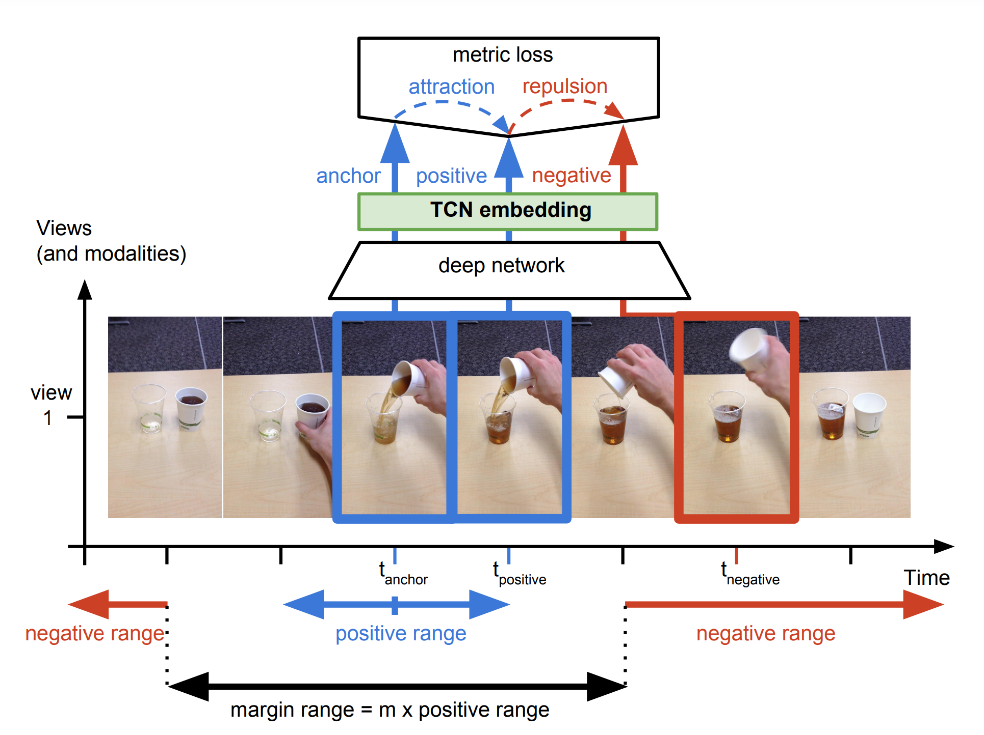
Self-Supervised Learning from Video
Notes:
Time-Contrastive Networks: Self-Supervised Learning from Video
https://www.youtube.com/watch?v=b1UTUQpxPSY

Slide 47
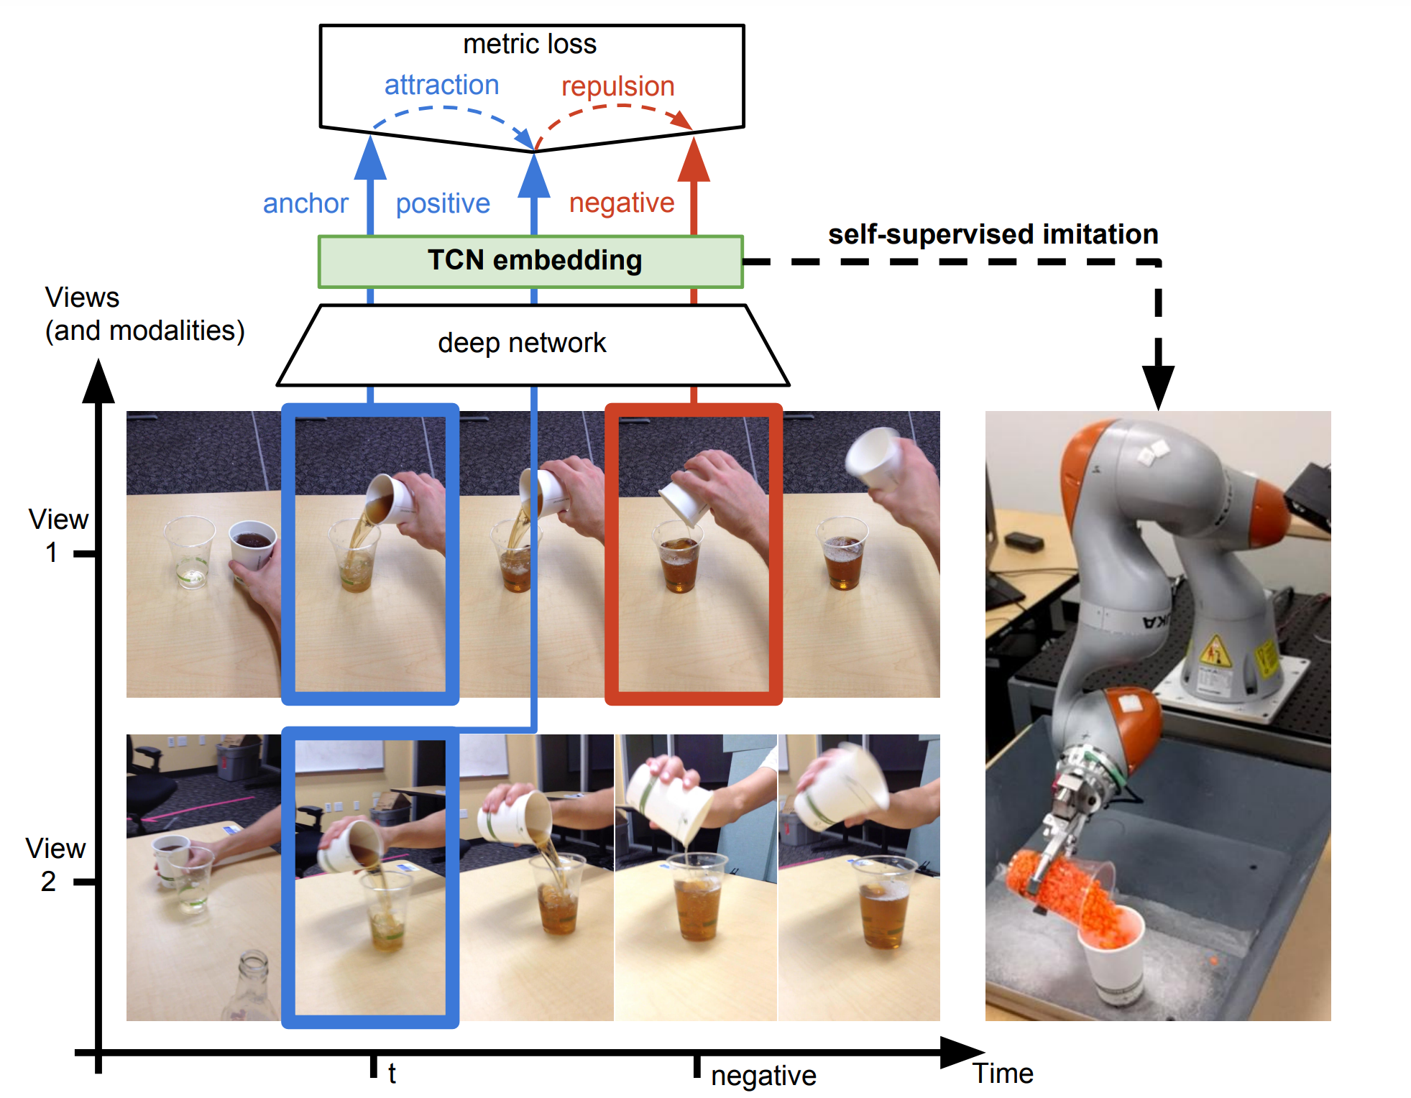
Self-Supervised Learning from Video
Notes:
之前介绍的方法大多是基于样本自身的信息，比如旋转、色彩、裁剪等。而样本间其实也是具有很多约束关系的，这里我们来介绍利用时序约束来进行自监督学习的方法。最能体现时序的数据类型就是视频了（video）
第一种思想是基于帧的相似性[17]，对于视频中的每一帧，其实存在着特征相似的概念，简单来说我们可以认为视频中的相邻帧特征是相似的，而相隔较远的视频帧是不相似的，通过构建这种相似（position）和不相似（negative）的样本来进行自监督约束

Slide 48
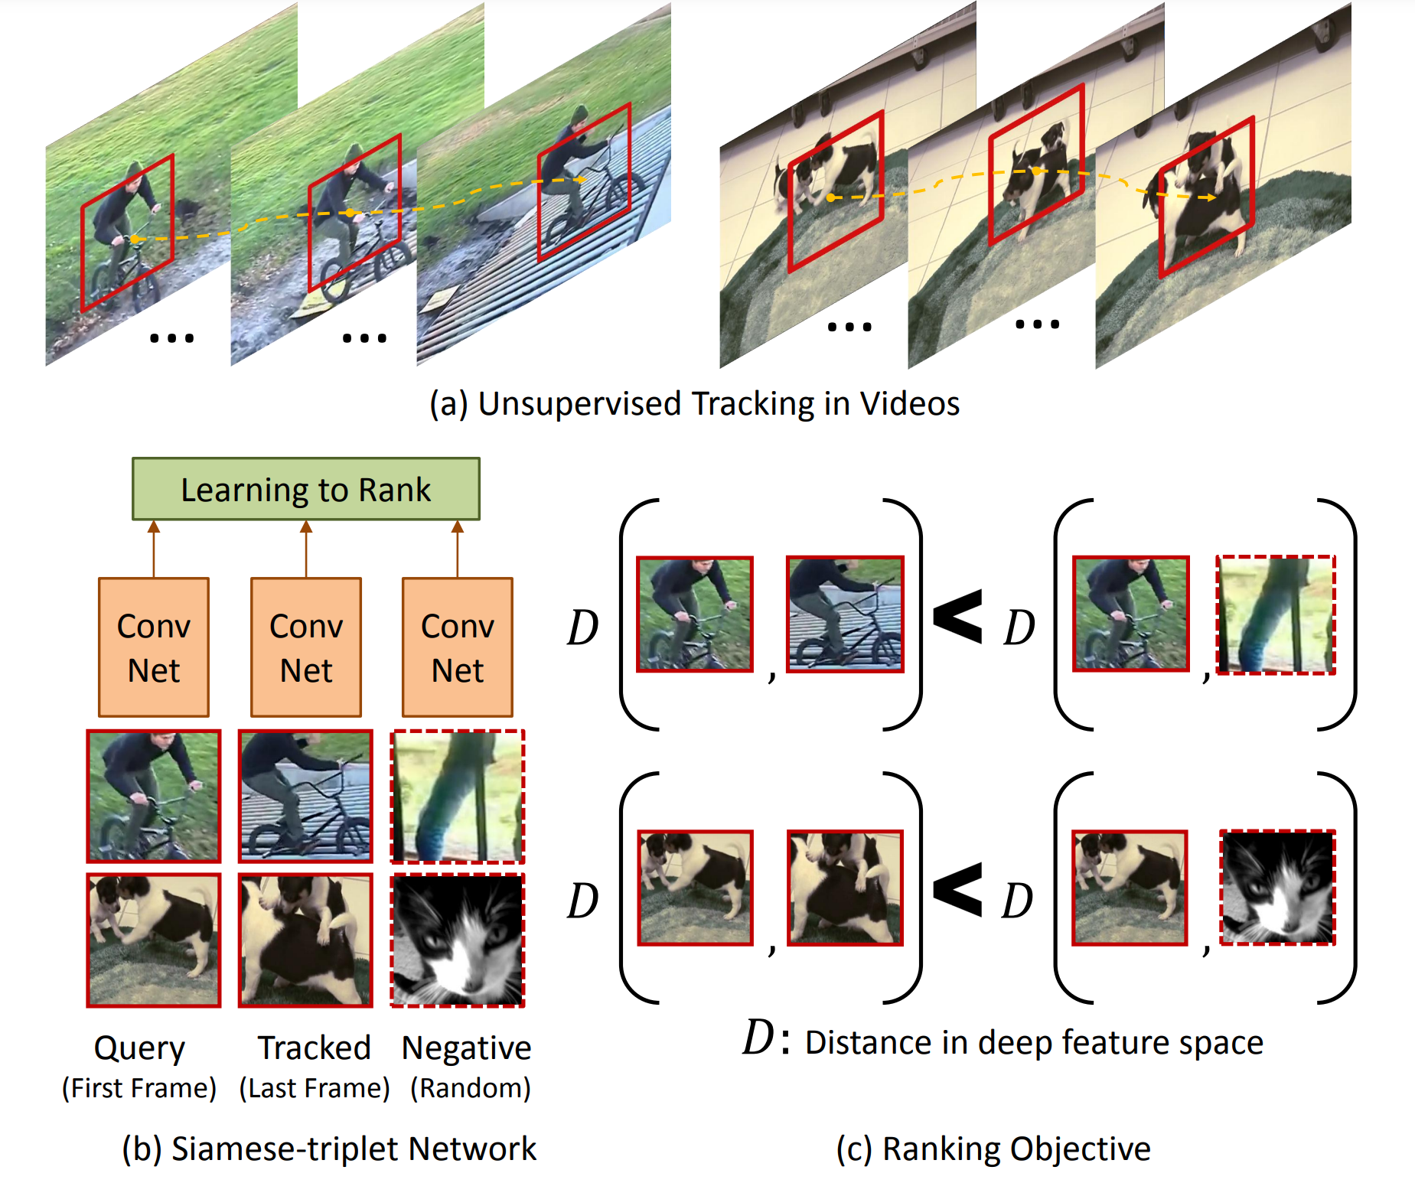
Self-Supervised Learning from Video
Notes:
Unsupervised Learning of Visual Representations using Videos
对于同一个物体的拍摄是可能存在多个视角（multi-view），对于多个视角中的同一帧，可以认为特征是相似的，对于不同帧可以认为是不相似的。
ICCV 2015 [18]的基于无监督追踪方法，首先在大量的无标签视频中进行无监督追踪，获取大量的物体追踪框。那么对于一个物体追踪框在不同帧的特征应该是相似的（positive），而对于不同物体的追踪框中的特征应该是不相似的（negative）

Slide 49
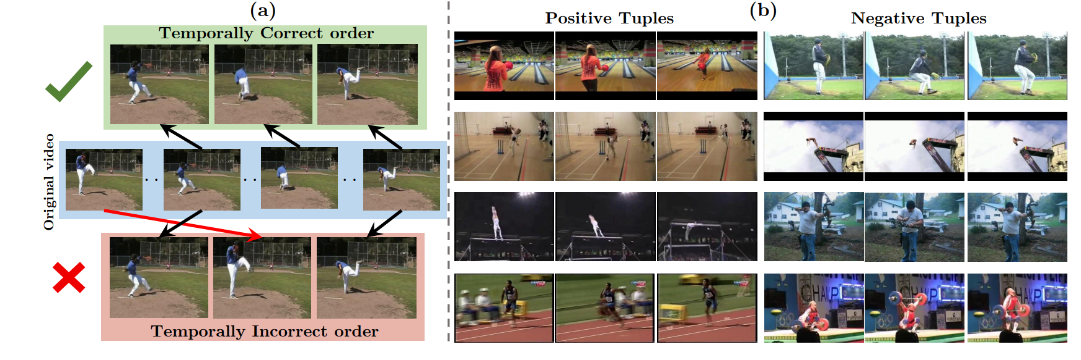
Self-Supervised Learning from Video
Notes:
除了基于特征相似性外，视频的先后顺序也是一种自监督信息。比如ECCV 2016, Misra, I. [19] 等人提出基于顺序约束的方法，可以从视频中采样出正确的视频序列和不正确的视频序列，构造成正负样本对然后进行训练。简而言之，就是设计一个模型，来判断当前的视频序列是否是正确的顺序。

Slide 50
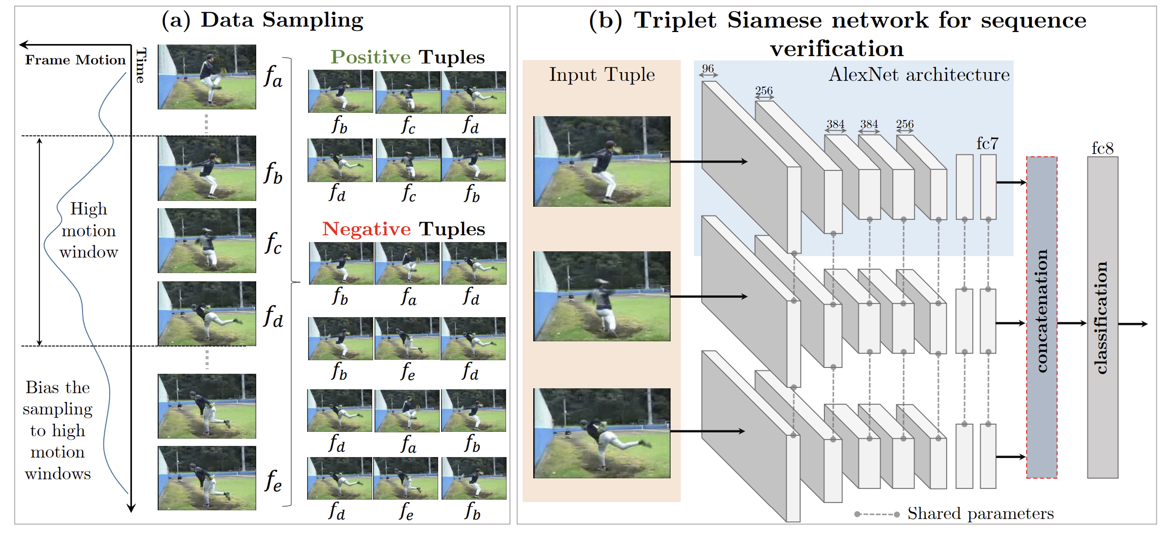
Self-Supervised Learning from Video

Slide 51
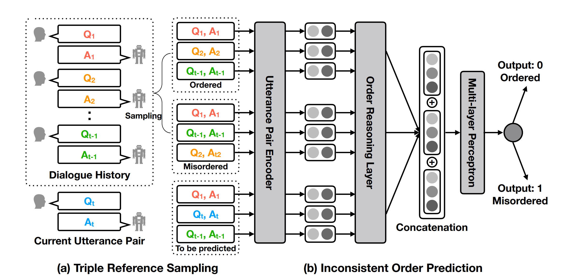
Self-Supervised Learning from Video
Notes:
基于顺序的约束还被应用了到了对话系统中，ACL 2019 [20] 提出的自监督对话学习就是基于这种思想。这篇文章主要是想解决对话系统中生成的话术连贯性的问题，期待机器生成的回复和人类交谈一样是符合之前说话的风格、习惯等等。从大量的历史预料中挖掘出顺序的序列（positive）和乱序的序列（negative），通过模型来预测是否符合正确的顺序来进行训练。训练完成后就拥有了一个可以判断连贯性的模型，从而可以嵌入到对话系统中，最后利用对抗训练的方式生成更加连贯的话术。

Slide 52
Cognitive Principles
Context based
Denoising Autoencoder
Relative patch prediction
Jigsaw puzzles
Predict one view from another
Task related self-supervised learning
Temporal based
Contrastive Learning
DIM
Contrastive Predictive Coding (CPC)
Memory Bank
SimCLR
Recent State-of-the-art progress

Slide 53
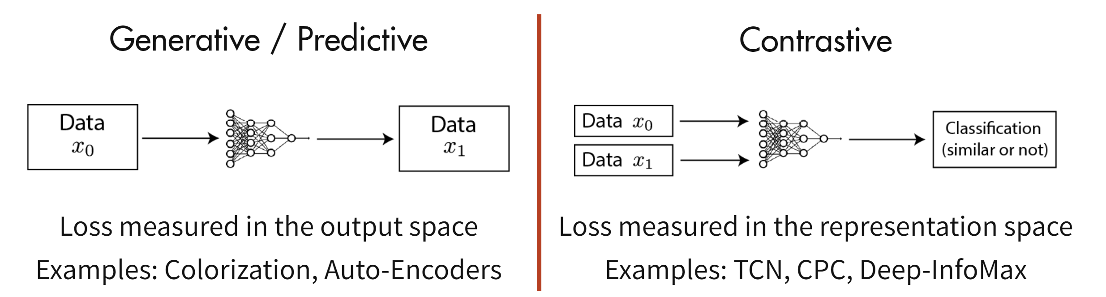
Contrastive learning
Contemporary self-supervised learning methods can roughly be broken down into two classes of methods
Contrastive methods, as the name implies, learn representations by contrasting positive and negative examples
Notes:
Contrastive methods trained on unlabelled ImageNet data and evaluated with a linear classifier now surpass the accuracy of supervised AlexNet. They also exhibit significant data efficiency when learning from labelled data compared to purely supervised learning (Data-Efficient CPC, Hénaff et al., 2019).
Contrastive pre-training on ImageNet successfully transfers to other downstream tasks and outperforms the supervised pre-training counterparts (MoCo, He et al., 2019).
https://ankeshanand.com/blog/2020/01/26/contrative-self-supervised-learning.html

Slide 54
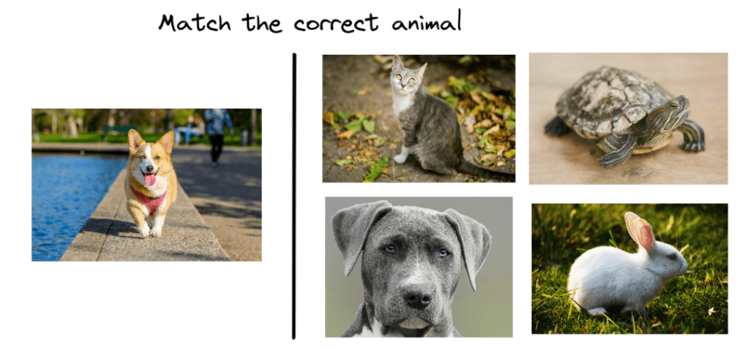
Contrastive learning
Below, we can see a traditional game that many kids play:
Notes:
According to many surveys, kids learn more easily new concepts in this way than reading a book about animals. But why does this method work better?
It turns out that it is easier for someone with no prior knowledge, like a kid, to learn new things by contrasting between similar and dissimilar things instead of learning to recognize them one by one. At first, the kid may not be able to identify the dog. But after some time, the kid learns to distinguish the common characteristics among dogs, like the shape of their nose and their body posture.

Slide 55
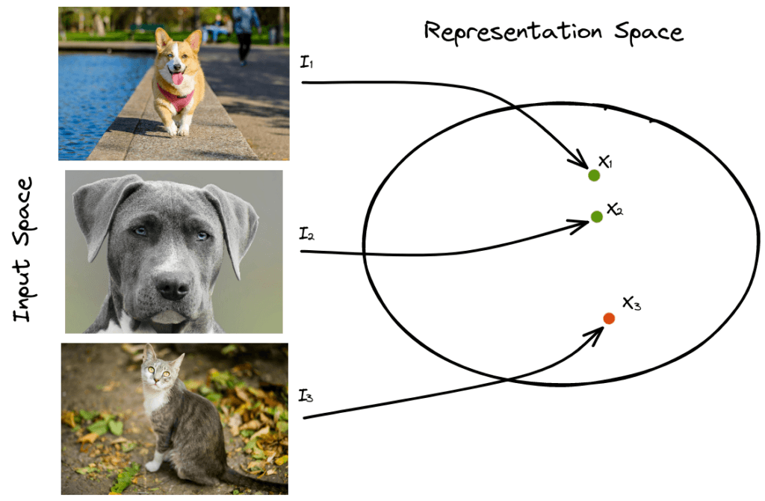
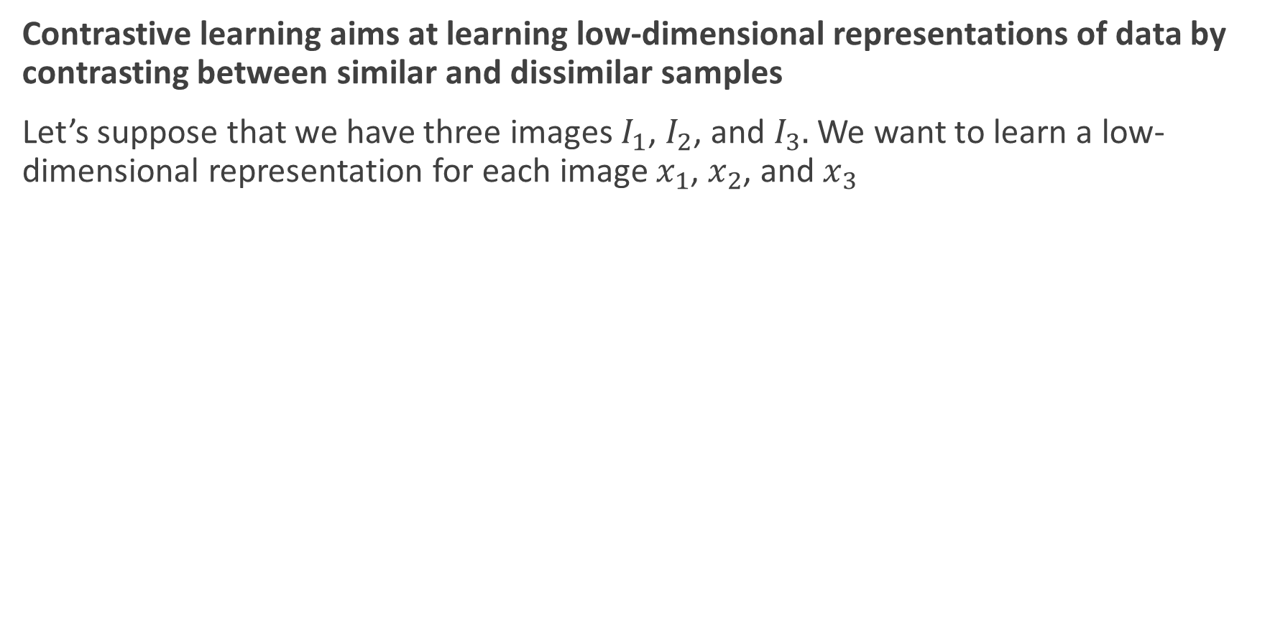
Contrastive learning
Contrastive learning aims at learning low-dimensional representations of data by contrasting between similar and dissimilar samples
Let’s suppose that we have three images $I_{1}$, $I_{2}$, and $I_{3}.$ We want to learn a low-dimensional representation for each image $x_{1}$, $x_{2}$, and $x_{3}$
Contrastive learning
Notes:
Specifically, it tries to bring similar samples close to each other in the representation space and push dissimilar ones to be far apart using the euclidean distance.

Slide 56
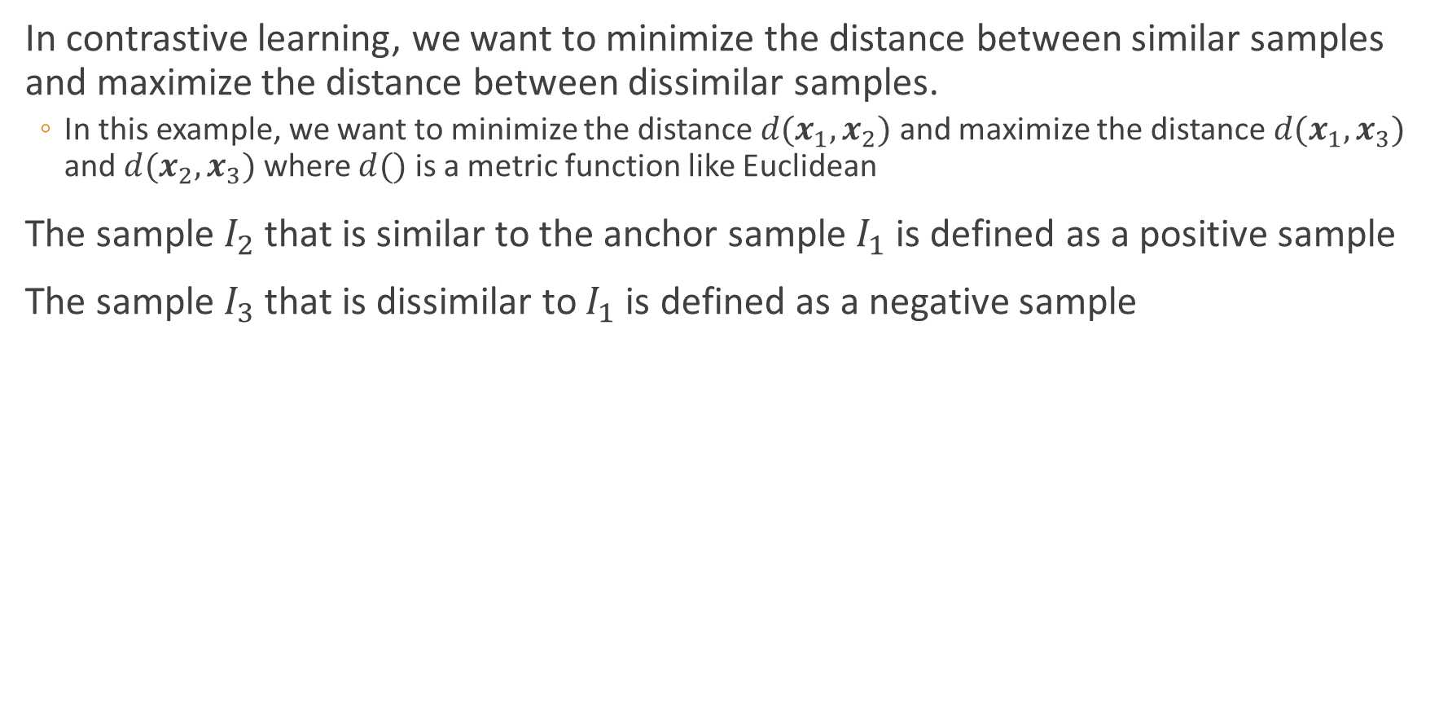
Contrastive learning
In contrastive learning, we want to minimize the distance between similar samples and maximize the distance between dissimilar samples.
In this example, we want to minimize the distance $d(x_{1},x_{2})$ and maximize the distance $d(x_{1},x_{3})$ and $d(x_{2},x_{3})$ where $d()$ is a metric function like Euclidean
The sample $I_{2}$ that is similar to the anchor sample $I_{1}$ is defined as a positive sample
The sample $I_{3}$ that is dissimilar to $I_{1}$ is defined as a negative sample
$$score\left(f\left(x\right),f(x^{+})\right)≫score\left(f\left(x\right),f(x^{−})\right)$$
Notes:
第三类自监督学习的方法是基于对比约束，它通过学习对两个事物的相似或不相似进行编码来构建表征，这类方法的性能目前来说是非常强的，从最近的热度就可以看出，很多大牛的精力都放在这个方向上面。关于这个方向的方法，[22] 总结的比较好。
这种基于对比的约束，通过构建正样本（positive）和负样本（negative），然后度量正负样本的距离来实现自监督学习。核心思想样本和正样本之间的相似度远远大于样本和负样本之间的相似度：（如何选取正负样本是工作的关键）
这里的 x 通常也称为 「anchor」数据，为了优化 anchor 数据和其正负样本的关系，我们可以使用点积的方式构造距离函数，然后构造一个 softmax 分类器，以正确分类正样本和负样本。这应该鼓励相似性度量函数（点积）将较大的值分配给正例，将较小的值分配给负例：

Slide 57
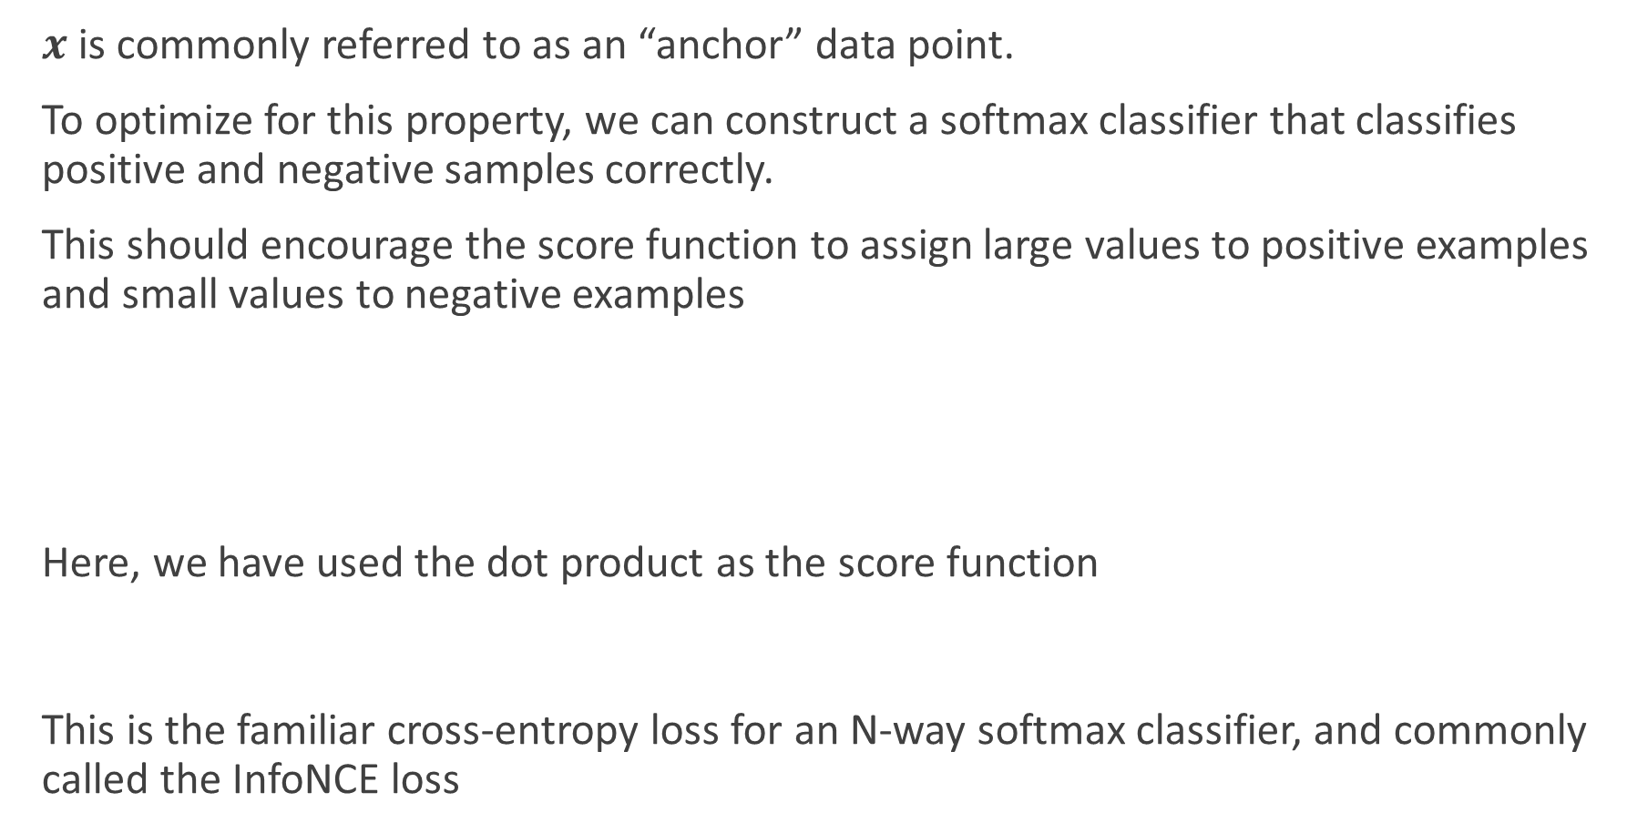
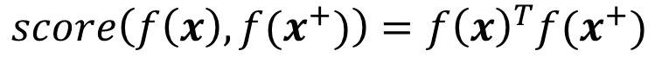
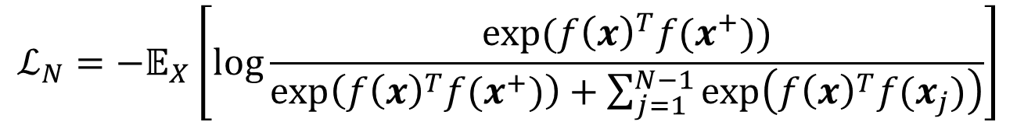
Contrastive learning
$x$ is commonly referred to as an “anchor” data point.
To optimize for this property, we can construct a softmax classifier that classifies positive and negative samples correctly.
This should encourage the score function to assign large values to positive examples and small values to negative examples
Here, we have used the dot product as the score function
This is the familiar cross-entropy loss for an N-way softmax classifier, and commonly called the InfoNCE loss
$$ℒ_{N}=−𝔼_{X}\left[\log{\frac{\exp{(f{\left(x\right)}^{T}f(x^{+}))}}{\exp\left(f{\left(x\right)}^{T}f(x^{+})\right)+\sum_{j=1}^{N−1}{\exp\left(f{\left(x\right)}^{T}f(x_{j})\right)}}}\right]$$
$$score\left(f\left(x\right),f(x^{+})\right)=f{\left(x\right)}^{T}f(x^{+})$$
Notes:
The InfoNCE objective is also connected to mutual information. Specifically, minimizing the InfoNCE loss maximizes a lower bound on the mutual information between f(X) and f(X+). See Poole et al., 2019 for a derivation and more details on this bound.

Slide 58
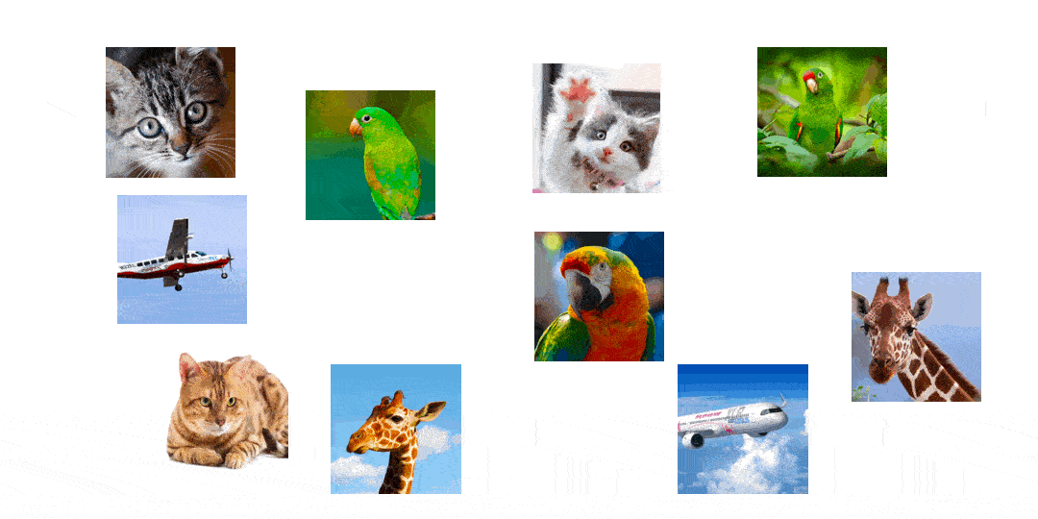
Contrastive learning

Slide 59
Similarity and dissimilarity
The similarity between two objects is a numerical measure of the degree to which the two objects are alike.
Similarities are higher for pairs of objects that are more alike.
The dissimilarity between two objects is a numerical measure of the degree to which the two objects are different.
Dissimilarities are lower for more similar pair of objects.
Frequently, the term distance is used as a synonym for dissimilarity.

Slide 60
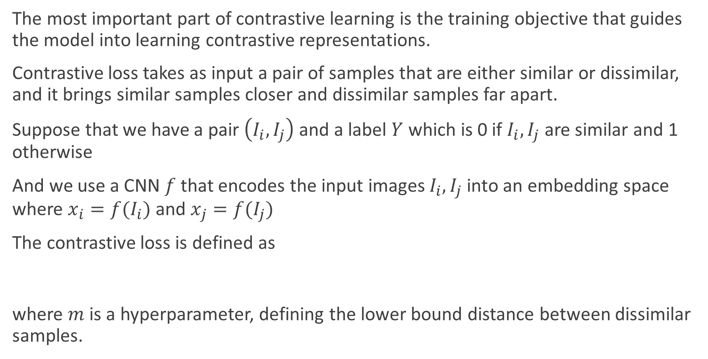
Contrastive Loss
The most important part of contrastive learning is the training objective that guides the model into learning contrastive representations.
Contrastive loss takes as input a pair of samples that are either similar or dissimilar, and it brings similar samples closer and dissimilar samples far apart.
Suppose that we have a pair $\left(I_{i},I_{j}\right)$ and a label $Y$ which is 0 if $I_{i},I_{j}$ are similar and 1 otherwise
And we use a CNN $f$ that encodes the input images $I_{i},I_{j}$ into an embedding space where $x_{i}=f(I_{i})$ and $x_{j}=f(I_{j})$
The contrastive loss is defined as
where $m$ is a hyperparameter, defining the lower bound distance between dissimilar samples.
$$L=\left(1−Y\right){\left\|x_{i}−x_{j}\right\|}^{2}+Y\max{(0,{m−\left\|x_{i}−x_{j}\right\|}^{2})}$$
Notes:
Contrastive loss is one of the first training objectives that was used for contrastive learning
。而当y=0时(即样本不相似)时，损失函数为(1-y)axmagin - d,0)2，即当样本不相似时，其特征空间的欧式距离反而小的话，损失值会变大，这也正好符号我们的要求。其中margin是一个超参，相当于是给loss定了一个上届(margin平方)如果d大于等于margin，那么说明已经优化的很好了，loss=0了

Slide 61
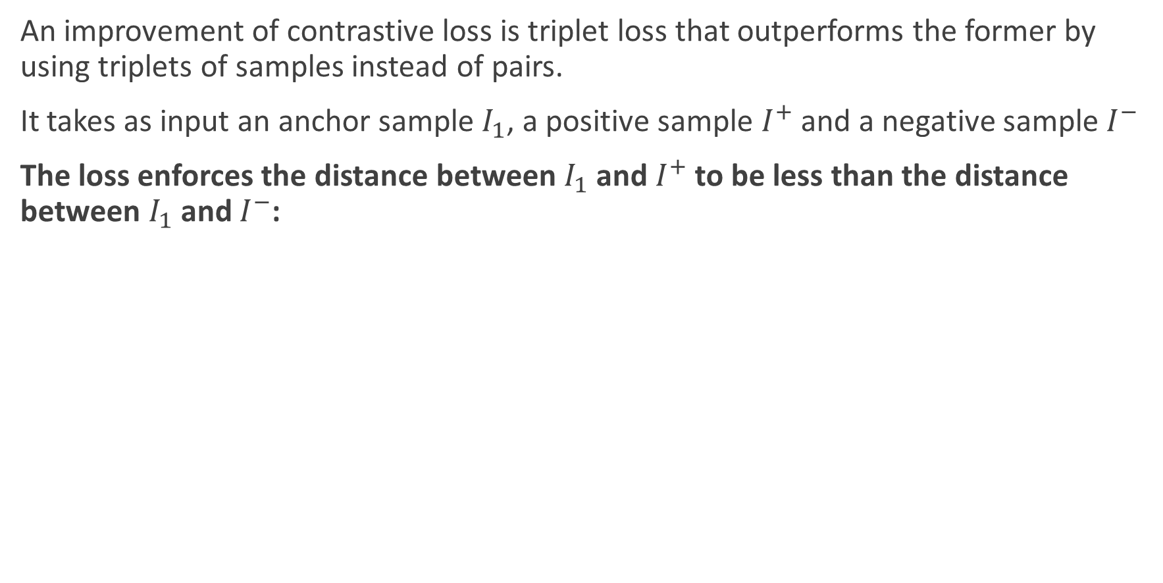
Triplet Loss
An improvement of contrastive loss is triplet loss that outperforms the former by using triplets of samples instead of pairs.
It takes as input an anchor sample $I_{1}$, a positive sample $I^{+}$ and a negative sample $I^{−}$
The loss enforces the distance between $I_{1}$and $I^{+}$to be less than the distance between $I_{1}$and $I^{−}$:
$$L=\max\left(0,{\left\|x−x^{+}\right\|}^{2}−{\left\|x−x^{−}\right\|}^{2}+m\right)$$
Notes:
When we train a model with the triplet loss, we require fewer samples for convergence since we simultaneously update the network using both similar and dissimilar samples. That’s why triplet loss is more effective than contrastive loss.

Slide 62
Self-supervised contrastive learning
In Self-Supervised Contrastive Learning (SSCL), the positive and negative samples are generated from the anchor image itself - by various data augmentation techniques.
Augmented versions of all other images are considered as “negative” samples.

Slide 63
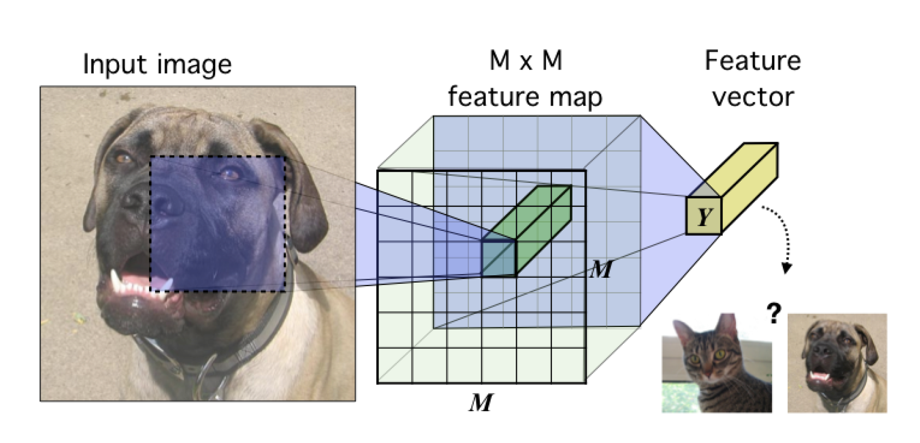
DIM (Deep InfoMax)
Notes:
我们首先介绍 ICLR 2019 的 DIM [23]，DIM 的具体思想是对于隐层的表达，我们可以拥有全局的特征（编码器最终的输出）和局部特征（编码器中间层的特征），模型需要分类全局特征和局部特征是否来自同一图像。所以这里 x 是来自一幅图像的全局特征，正样本是该图像的局部特征，而负样本是其他图像的局部特征。这个工作的开创性很强，已经被应用到了其他领域，比如 graph [24]。
Hjelm, R. Devon et al. “Learning deep representations by mutual information estimation and maximization.” . ICLR 2019
Deep InfoMax (DIM, Hjelm et al., 2018) learns representations of images by leveraging the local structure present in an image. The contrastive task behind DIM is to classify whether a pair of global features and local features are from the same image or not. Here, global features are the final output of a convolutional encoder (a flat vector, Y) and local features are the output of an intermediate layer in the encoder (an M x M feature map). Each local feature map has a limited receptive field. So, intuitively this means to do well at the contrastive task the global feature vector must capture information from all the different local regions.

Slide 64
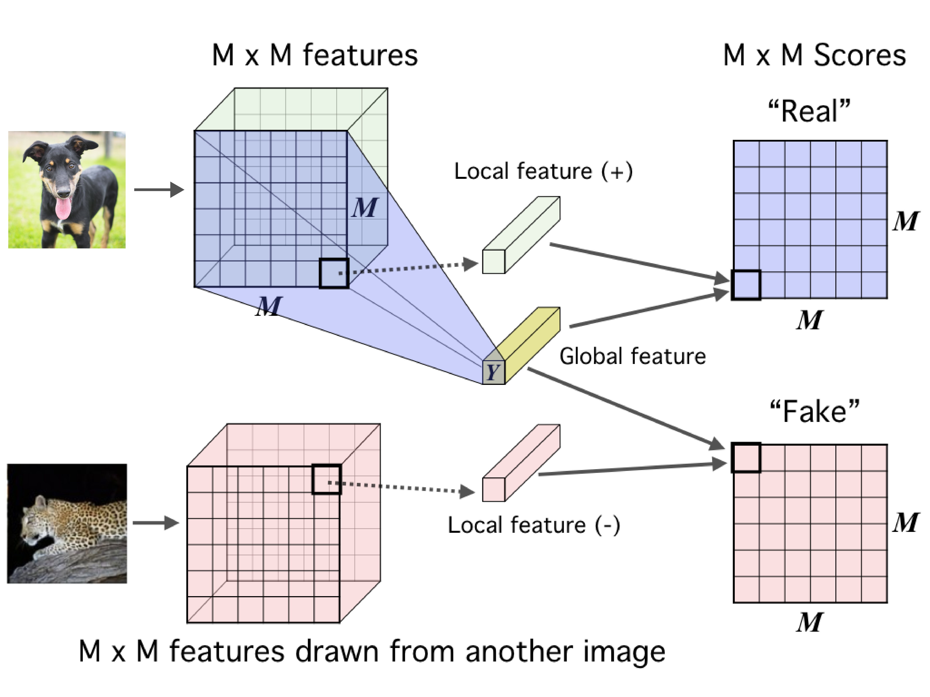
DIM (Deep InfoMax)
Notes:
The loss function for DIM looks exactly as the contrastive loss function we described above. Given an anchor image x,
f(x) refers to the global features.
f(x+) refers to the local features from the same image (positive samples).
f(x−) refers to the local features from a different image (negative samples).

Slide 65
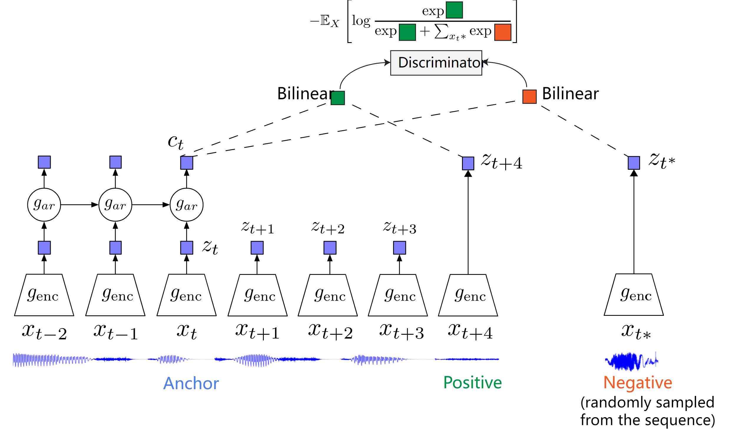
Contrastive Predictive Coding (CPC)
Notes:
CPC 同样是一个基于对比约束的自监督框架，主要是可以应用于能够以有序序列表示的任何形式的数据:文本、语音、视频、甚至图像（图像可以被视为像素或块的序列，后面作者也给出了具体的想法）。CPC 主要是利用自回归的想法，对相隔多个时间步长的数据点之间共享的信息进行编码来学习表示，这个表示 c_t 可以代表融合了过去的信息，而正样本就是这段序列 t 时刻后的输入，负样本是从其他序列中随机采样出的样本。CPC的主要思想就是基于过去的信息预测的未来数据，通过采样的方式进行训练。
Oord, Aäron van den et al. “Representation Learning with Contrastive Predictive Coding.” ArXiv abs/1807.03748 (2018)
Contrastive Predictive Coding (CPC, van den Oord et al., 2018) is a contrastive method that can be applied to any form of data that can be expressed in an ordered sequence: text, speech, video, even images (an image can be seen as a sequence of pixels or patches).
CPC learns representations by encoding information that’s shared across data points multiple time steps apart, discarding local information. These features are often called “slow features”: features that don’t change too quickly across time. Examples include identity of a speaker in an audio signal, an activity carried out in a video, an object in an image etc.
The contrastive task in CPC is set as follows. Let {x1,x2,…,xN} be a sequence of data points, and xt be an anchor data point. Then,
xt+k will be a positive sample for this anchor.
A data point xt* randomly sampled from the sequence will be a negative sample
CPC makes use of multiple ks in a single task to capture features evolving at different time scales.

Slide 66
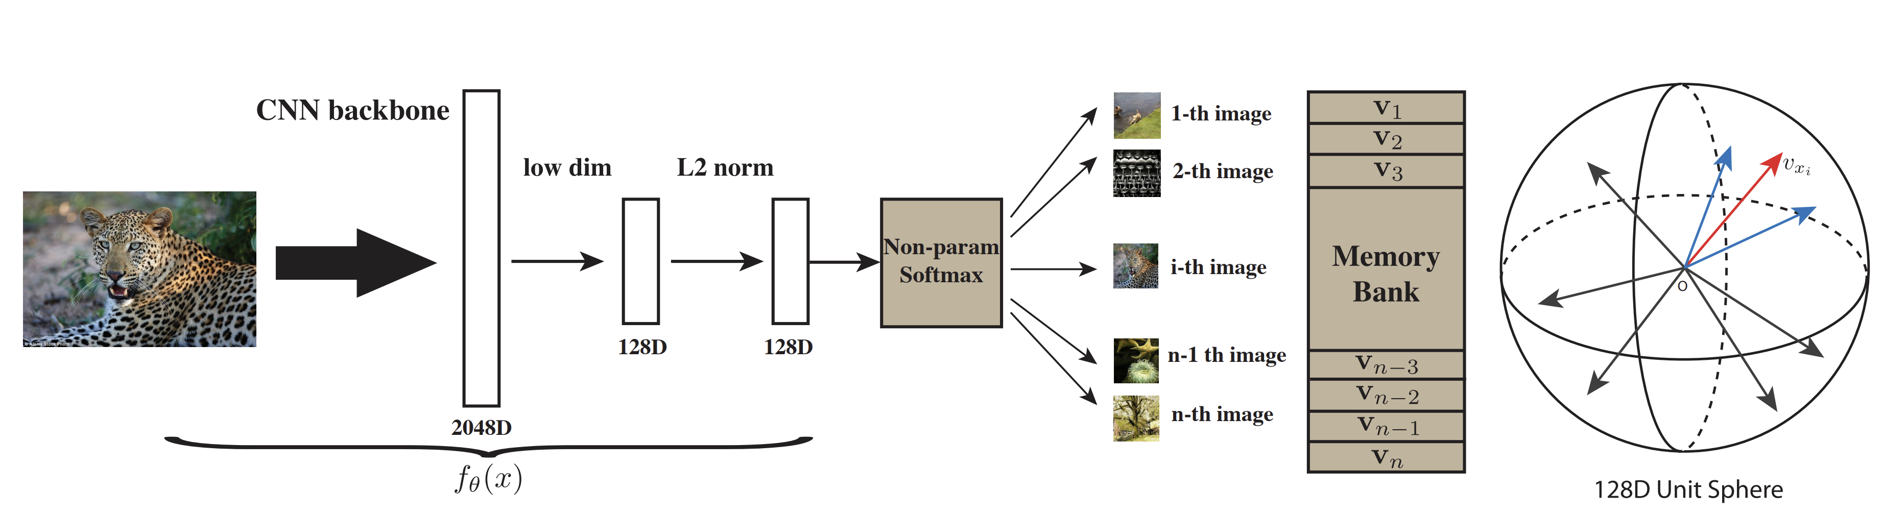
Memory Bank
Notes:
对于具体的实现上，因为存在大量的样本，如何存取和高效的计算损失是急需解决的。研究人员提出了memory bank [27]的概念，也就是说我们把之前模型产生样本特征全部存起来，当前计算损失的时候直接拿来用就可以了，每次模型更新完后将当前的特征重新更新到 memory bank 中，以便下一次使用。这个工作的缺点就在于每次需要将所有样本的特征全部存起来。后续 kaiming 大神提出的 Moco[28]， 主要的贡献是 Momentum Update、 shuffleBN 等技术点来优化这个过程。关于 Moco 知乎上已经有了很多的解释了，推荐大家阅读 [2]，这里我们就不展开介绍了。
Wu, Zhirong et al. “Unsupervised Feature Learning via Non-parametric Instance Discrimination.” CVPR 2018

Slide 67
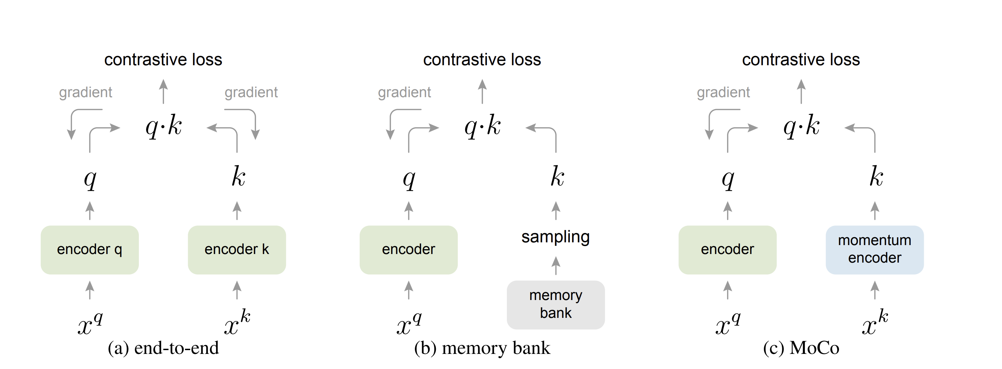
MOCO
Notes:
https://ankeshanand.com/blog/2020/01/26/contrative-self-supervised-learning.html
Comparison of different strategies of using negative samples in contrastive methods. Here xq are positive examples, and xk are negative examples. Note that the gradient doesn’t flow back through the momentum encoder in MoCo.

Slide 68
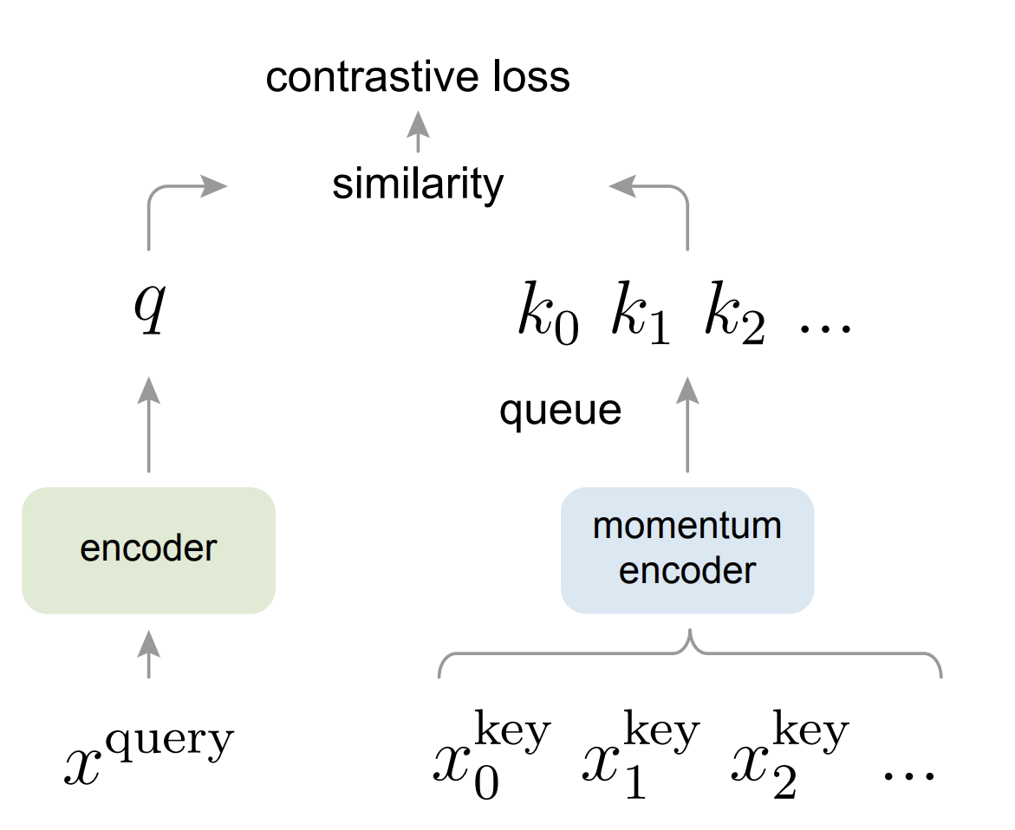
MOCO

Slide 69
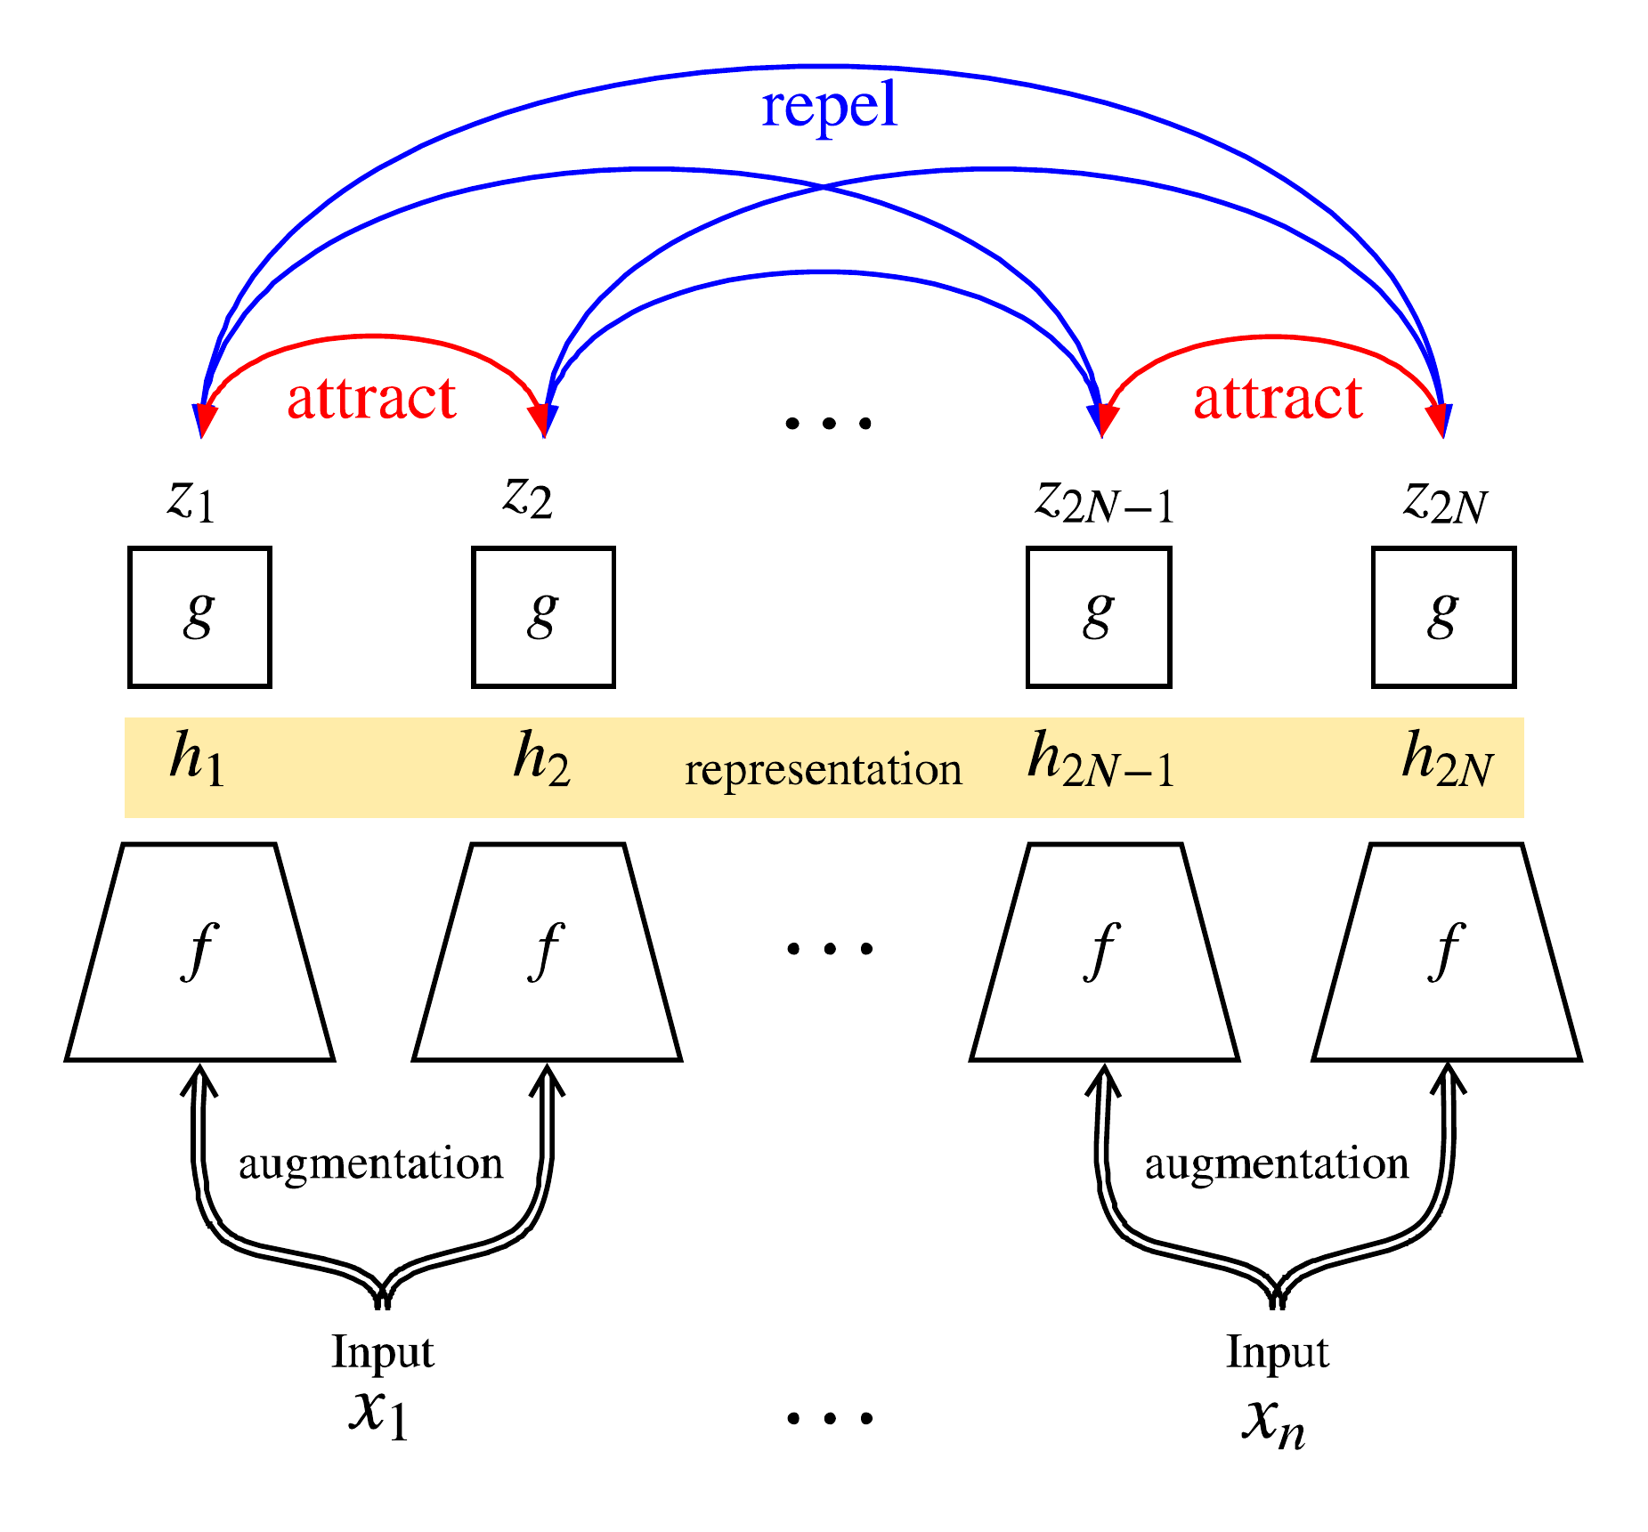
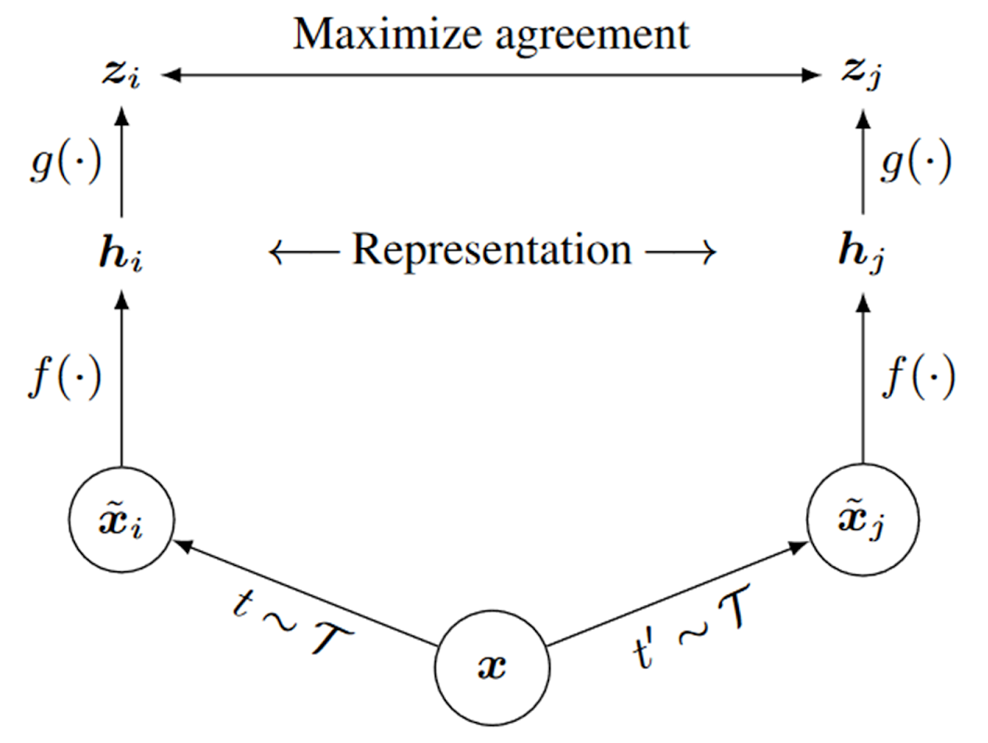
SimCLR
Notes:
Its basic working principle is to maximize the agreement between different augmented versions of the same sample using a contrastive loss in the latent space.
1. A data augmentation module that transforms a given data sample (image) randomly to create two views of the same example (“x_i” and “x_j” in the diagram above). These represent the positive pairs. The SimCLR framework applies the following three augmentations: random crop and resizing (with random flip), color distortions, and Gaussian blur. According to the results obtained by the authors, random cropping and color distortion are essential for achieving good performance.
2. SimCLR consists of a neural network base encoder, denoted by “f(.)” in the architecture diagram, to extract representative vectors from the augmented data samples. Although we can use any network as the backbone encoder, the authors chose the ResNet model for simplicity. The features are extracted after the final averaging pooling layer of the ResNet-50 model.
3. Next, a small neural network projection head, denoted by “g(.),” is incorporated to map the extracted representative vectors to a common latent space. This will allow the contrastive loss to be implemented. The authors use a simple Multi-Layer Perceptron with one hidden layer for this purpose. They investigated and found that applying the contrastive loss in this latent space produces better results than directly evaluating the loss over the features extracted from ResNet-50.
4. Finally, a contrastive loss function is defined based on previous literature, which the authors chose to be the NT-Xent loss function that has been explained in the previous section.

Slide 70
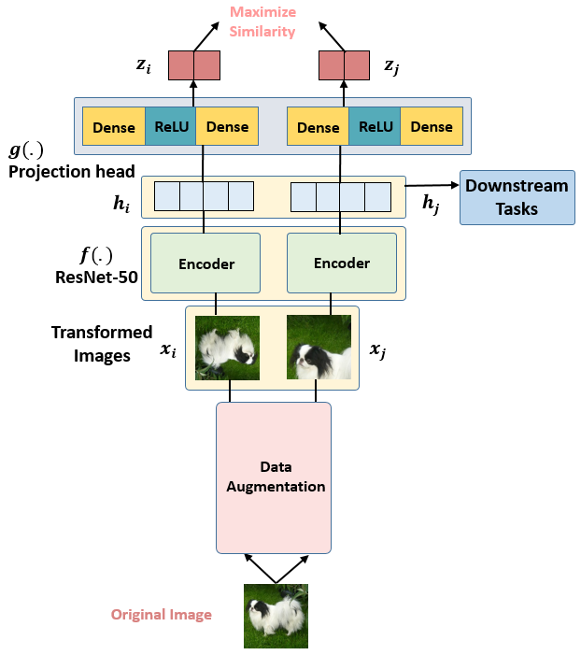
SimCLR
Notes:
最近 hinton 组又放出了 SimCLR[29]，这个工作主要是对于一个输入的样本，进行不同的数据增广方式，对于同一个样本的不同增广是正样本，对于不同样本的增广是负样本。整个过程比之前kaiming提出的动量对比（MoCo）更加的简单，同时省去了数据存储队列。这个工作的创新主要有两个：在表征层和最后的损失层增加了一个非线性映射可以增加性能 （这个地方我比较好奇，希望能有大佬给出更直观的解释）。数据增广对于自监督学习是有益的，不同数据增广方式的结合比单一增广更好。同时作者公布了非常多的实验经验，比如自监督学习需要更大的 batch 和更长的训练时间。
Chen, Ting et al. “A Simple Framework for Contrastive Learning of Visual Representations.” ArXiv abs/2002.05709 (2020)
https://www.v7labs.com/blog/contrastive-learning-guide

Slide 71
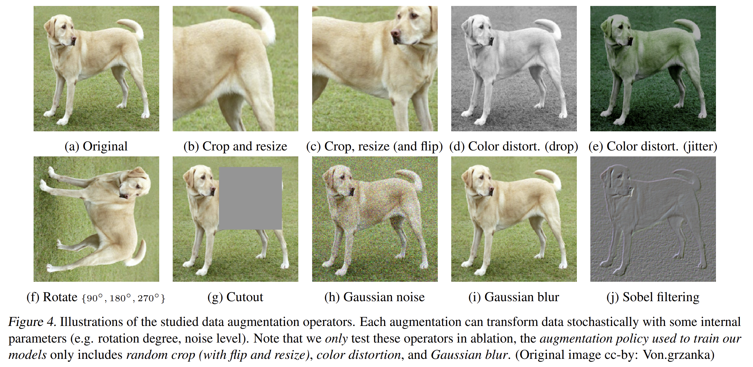
SimCLR

Slide 72
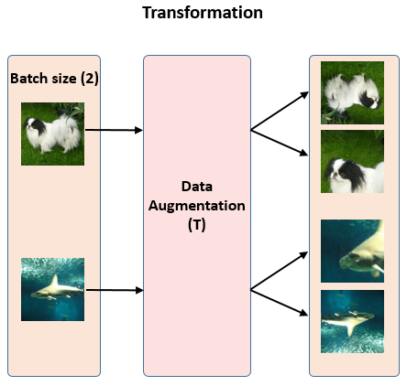
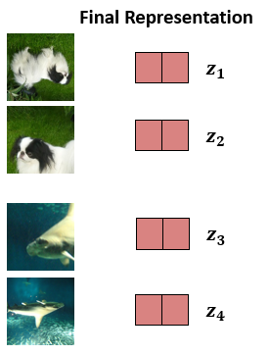
SimCLR
Notes:
Self-Supervised Learning 超详细解读 (二)：SimCLR系列 - 知乎 (zhihu.com)

Slide 73
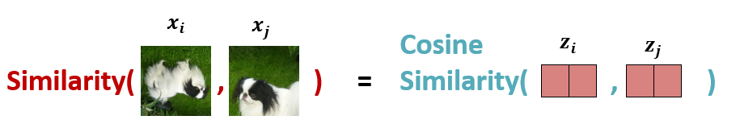
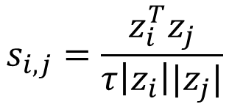
SimCLR
$$s_{i,j}=\frac{z_{i}^{T}z_{j}}{τ\left|z_{i}\right||z_{j}|}$$

Slide 74
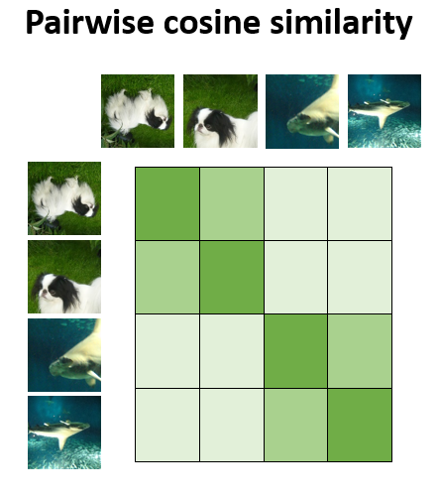
SimCLR

Slide 75
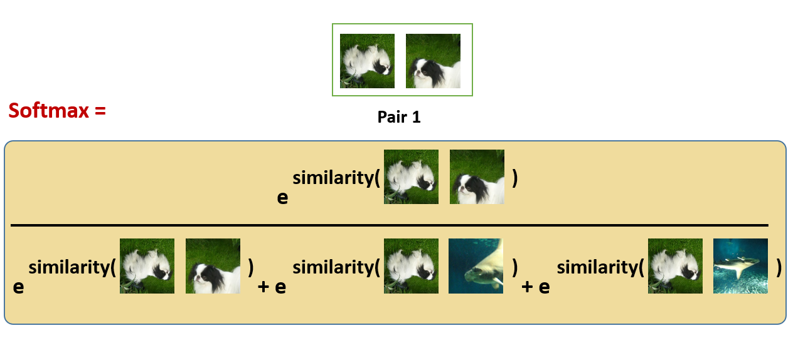
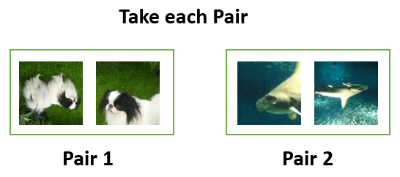
SimCLR
Notes:
使用 softmax 函数来获得这两个图像相似的概率
这种 softmax 计算等价于获得第2张增强的狗的图像与该对中的第1张狗的图像最相似的概率。 在这里，分母中的其余的项都是其他图片的增强之后的图片，也是negative samples。
所以我们希望上面的softmax的结果尽量大，所以损失函数取了softmax的负对数：

Slide 76
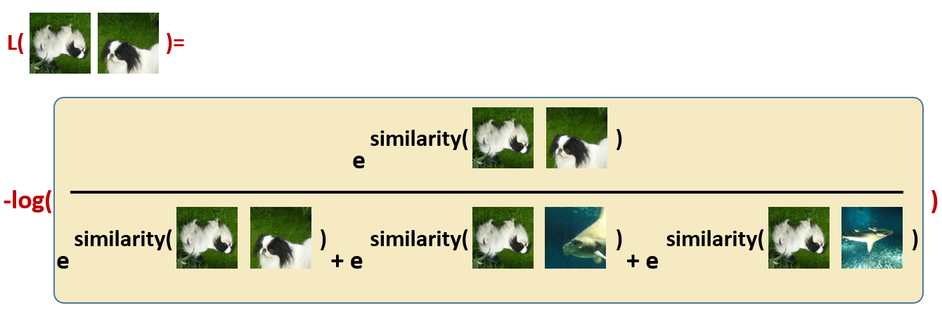
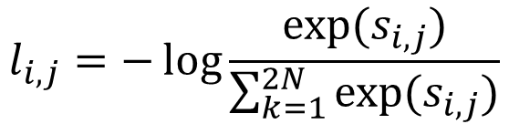
Normalized temperature-scaled cross entropy (NT-Xent)
NT-Xent loss
$$l_{i,j}=−\log{\frac{\exp{(s_{i,j})}}{\sum_{k=1}^{2N}{\exp{(s_{i,j})}}}}$$
Notes:
对比损失函数，也称为归一化温度标度交叉熵损失 (NT-Xent)，是 SimCLR 的一个关键组成部分，它鼓励模型学习相同图像的相似表示和不同图像的不同表示
深度了解自监督学习，就看这篇解读 ！Hinton团队力作：SimCLR系列 (360doc.com)

Slide 77
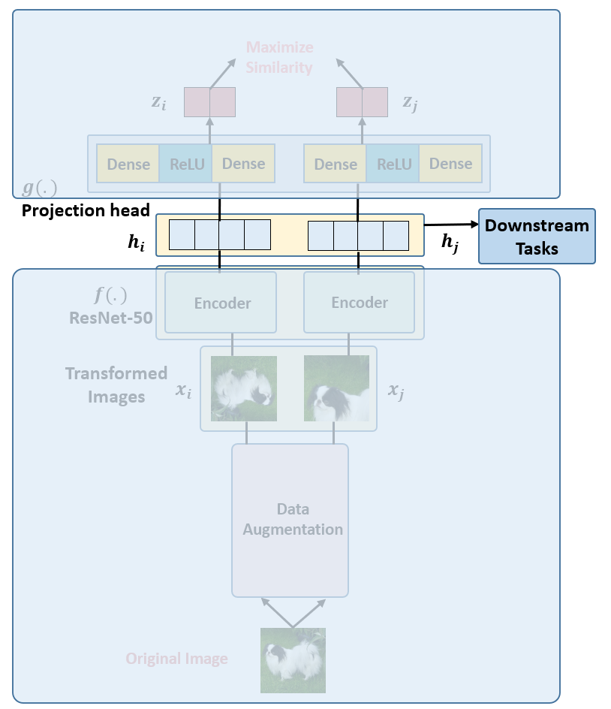
SimCLR

Slide 78
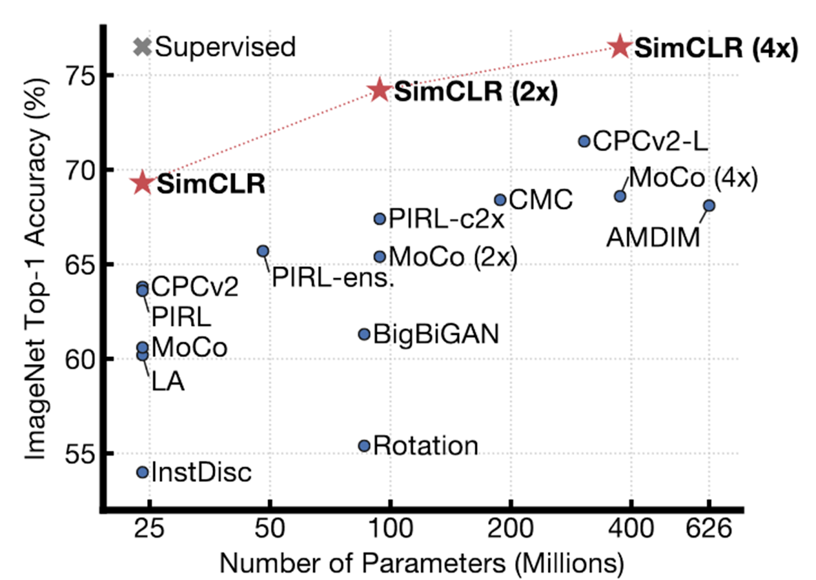
SimCLR

Slide 79
Distance

Slide 80
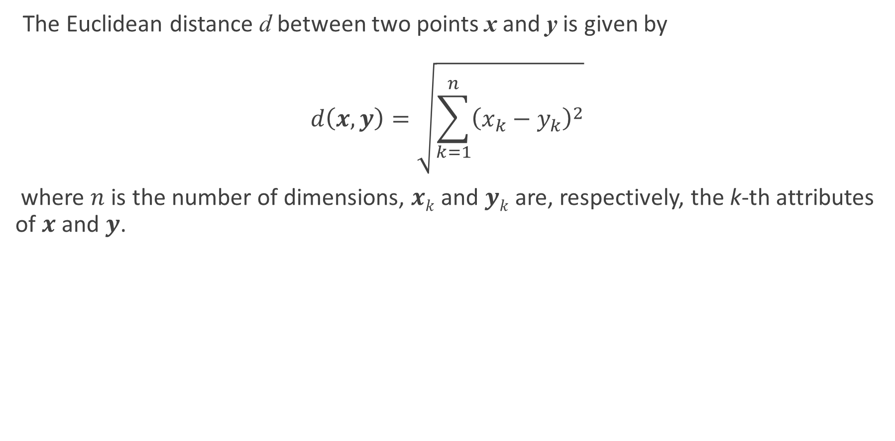
Metric
The Euclidean distance d between two points x and y is given by
$$d\left(x,y\right)=\sqrt{\sum_{k=1}^{n}{{\left(x_{k}−y_{k}\right)}^{2}}}$$
where $n$ is the number of dimensions, $xk$ and $yk$ are, respectively, the k-th attributes of $x$ and $y$.

Slide 81

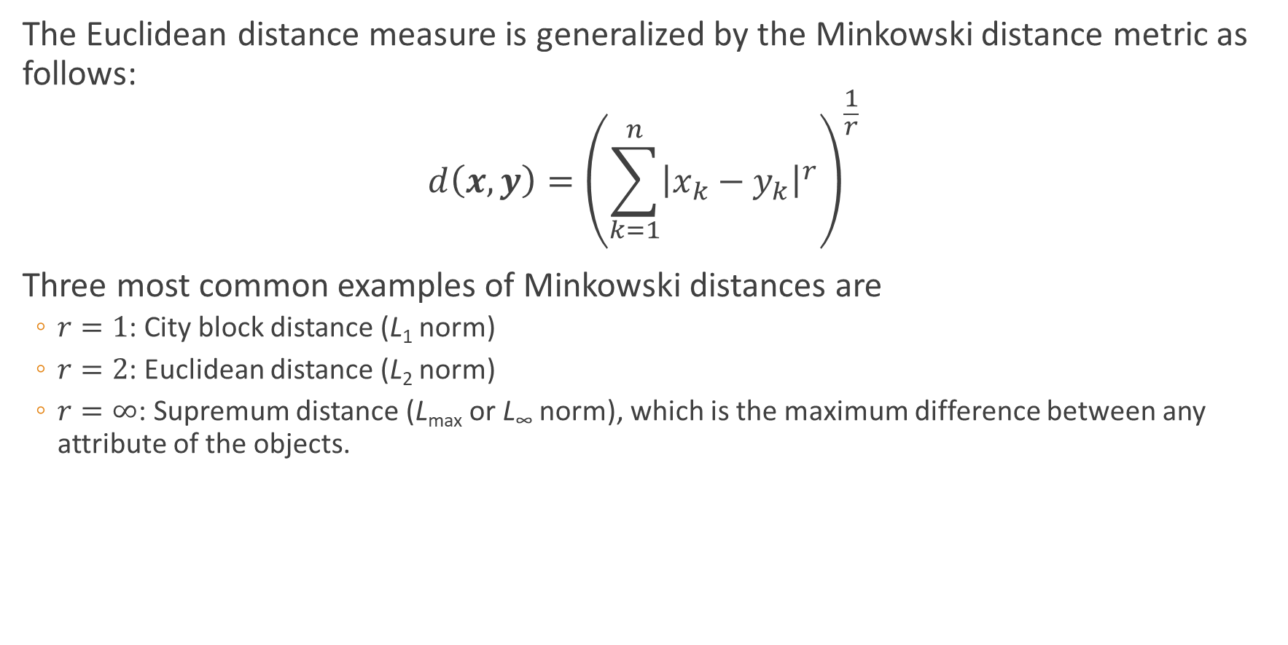
Metric
The Euclidean distance measure is generalized by the Minkowski distance metric as follows:
$$d\left(x,y\right)={\left(\sum_{k=1}^{n}{{\left|x_{k}−y_{k}\right|}^{r}}\right)}^{\frac{1}{r}}$$
Three most common examples of Minkowski distances are
$r=1$: City block distance (L₁ norm)
$r=2$: Euclidean distance (L₂ norm)
$r=∞$: Supremum distance (L_{max} or L∞ norm), which is the maximum difference between any attribute of the objects.

Slide 82


Metric
A distance measure has some well-known properties
Positivity
$d(x, y) ≥ 0$for all $x$ and $y$
$d(x, y) = 0$if and only if $x = y$
Symmetry
$d(x, y) = d(y, x)$for all $x$ and $y$.
Triangle inequality
$d(x, z) ≤ d(x, y) + d(y, z)$ for all points $x$, $y$ and $z$.

Slide 83

Metric learning
In the previous discussion, all attributes were treated equally when computing proximity.
This is not desirable when some attributes are more important than others.
To address these situations, the distance measure can be modified by weighting the contribution of each attribute:
$$d\left(x,y\right)={\left(\sum_{k=1}^{n}{{w_{k}\left|x_{k}−y_{k}\right|}^{r}}\right)}^{\frac{1}{r}}$$

Slide 84

Divergence
A divergence is a kind of statistical distance: a binary function which establishes the separation from one probability distribution to another on a statistical manifold.
The simplest divergence is squared Euclidean distance (SED),
Another most important divergence is relative entropy (also called Kullback–Leibler divergence)
Given a differentiable manifold, $M$ of dimension $n$, a divergence on $M$ is a $C^{2}$-function $D:M×M→\left[0,∞\right)$ satisfying:
1. $D\left(p,q\right)≥0$ for all $p,q∈M$ (non-negativity)
2. $D\left(p,q\right)=0$ if and only if $p=q$ (positivity)
3. At every point $p∈M$, $D(p,p+dp)$ is a positive-definite quadratic form for infinitesimal displacements $dp$ from $p$
Notes:
divergences can be viewed as generalizations of SED.
C² (continuous with continuous first and second derivatives)
Condition 3 means that D defines an inner product on the tangent space T_pM for every p∈M. Since D is C^2 on M, this defines a Riemannian metric g on M.

Slide 85

Divergence
Unlike metrics, divergences are not required to be symmetric, and the asymmetry is important in applications.
Divergences generalize squared distance, not linear distance, and thus do not satisfy the triangle inequality.
In general statistics and probability, “divergence” generally refers to any kind of function $D(p,q)$, where $p$, $q$ are probability distributions
The two most important divergences are the relative entropy (KL divergence), which is central to information theory and statistics, and the squared Euclidean distance (SED).
The two most important classes of divergences are the f-divergences and Bregman divergences.

Slide 86





f-divergences
Given a convex function $f:\left[0,∞\right)→\left(−∞,+∞\right]$ such that $f\left(0\right)=\lim_{t→0^{+}}f\left(t\right),f\left(1\right)=0$, the f-divergence generated by $f$ is defined as
$$D_{f}\left(p,q\right)=\int{p\left(x\right)f\left(\frac{q\left(x\right)}{p\left(x\right)}\right)dx}$$
Kullback–Leibler divergence
squared Hellinger distance
Jensen–Shannon divergence
$$D_{KL}\left(p,q\right)=\int{p\left(x\right)\ln\left(\frac{q\left(x\right)}{p\left(x\right)}\right)dx}$$
$$H^{2}\left(p,q\right)=2\int{{\left(\sqrt{p\left(x\right)}−\sqrt{q\left(x\right)}\right)}^{2}dx}$$
$$D_{JS}\left(p,q\right)=\frac{1}{2}\int{\left(p\left(x\right)−q\left(x\right)\right)(ln{p\left(x\right)−ln⁡(q(x)))}dx}$$

Slide 87

Bregman divergences
Bregman divergences correspond to convex functions on convex sets.
Given a strictly convex, continuously differentiable function $F$ on a convex set, known as the Bregman generator, the Bregman divergence measures the convexity of: the error of the linear approximation of $F$ from $q$ as an approximation of the value at $p$:
$$D_{F}\left(p,q\right)=F\left(p\right)−F\left(q\right)−\left\langle ∇F\left(q\right),p−q\right\rangle$$
Notes:
https://en.wikipedia.org/wiki/Bregman_divergence

Slide 88

Kullback-Leibler divergence
The Kullback–Leibler divergence, denoted $D_{KL}(P||Q)$, is a type of statistical distance: a measure of how one probability distribution $P$ is different from a second, reference probability distribution $Q$
While it is a distance, it is not a metric, the most familiar type of distance: it is not symmetric in the two distributions, and does not satisfy the triangle inequality
A relative entropy of 0 indicates that the two distributions in question have identical quantities of information
Relative entropy is a nonnegative function of two distributions or measures
Notes:
A simple interpretation of the KL divergence of P from Q is the expected excess surprise from using Q as a model when the actual distribution is P

Slide 89

Kullback-Leibler divergence
Consider two probability distributions $P$ and $Q$.
Usually, $P$ represents the data, the observations, or a measured probability distribution.
Distribution $Q$ represents instead a theory, a model, a description or an approximation of $P$.
The Kullback-Leibler divergence is then interpreted as the average difference of the number of bits required for encoding samples of $P$ using a code optimized for $Q$ rather than one optimized for $P$

Slide 90



Kullback-Leibler divergence
For discrete probability distributions $P$ and $Q$defined on the same sample space, $𝒳$ the relative entropy from $Q$ to $P$ is defined to be
It is the expectation of the logarithmic difference between the probabilities $P$ and $Q$where the expectation is taken using the probabilities $P$.
For distributions $P$ and $Q$ of a continuous random variable, relative entropy is defined to be the integral
where $p$ and $q$ denote the probability densities of $P$ and $Q$
$$D_{KL}\left(P||Q\right)=\sum_{x∈𝒳}{P\left(x\right)\log\left(\frac{P(x)}{Q(x)}\right)}$$
$$D_{KL}\left(P||Q\right)=\int_{−∞}^{∞}{p\left(x\right)\log\left(\frac{p(x)}{q(x)}\right)}$$

Slide 91



Kullback-Leibler divergence
Example: Let $P$ and $Q$be the distributions shown in the table and figure. $P$ is the distribution on the left side of the figure, a binomial distribution with $N=2$ and $p=0.4$. $Q$ is the distribution on the right side of the figure, a discrete uniform distribution with the three possible outcomes $x=0, 1, 2$ (i.e. $𝒳=\{0,1,2\}$), each with probability $p=1/3$.

Slide 92

Kullback-Leibler divergence

Slide 93
Cross entropy

Slide 94
Logistic Loss
The logistic loss is a simple convex loss function popularly used in Supervised Learning literature

